Slide 1
The pivot role of modelling in problem-solving issues in continuous casting of steel: a project clustering experience in the European programmes frame
M. De Santis, O. Di Pietro (RINA-CSM), N. Egido Perez, D. Mier Vasallo (SIDENOR), C. Gruber (K1-MET), K. Marx, M. Koester (BFI), P. Ramirez Lopez (SWERIM)

Slide 2
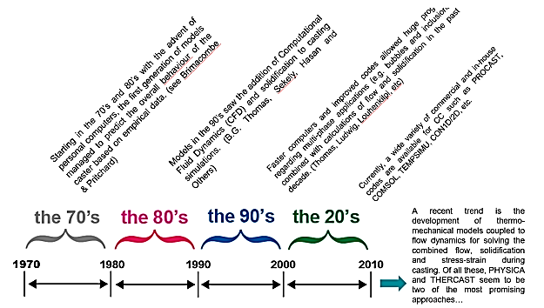
The pivot role of modelling in problem-solving issues in continuous casting of steel: a project clustering experience….
Starting point: the huge modelling potential achieved through RFCS projects* for problem-solving in European steel industry.
Recent advances on modelling disseminated in 3 areas:
Fundamental Research
Industrial Applications
Decision-Making
* from VALCRA Project reports, RFCS-GA No. 84719

Slide 3
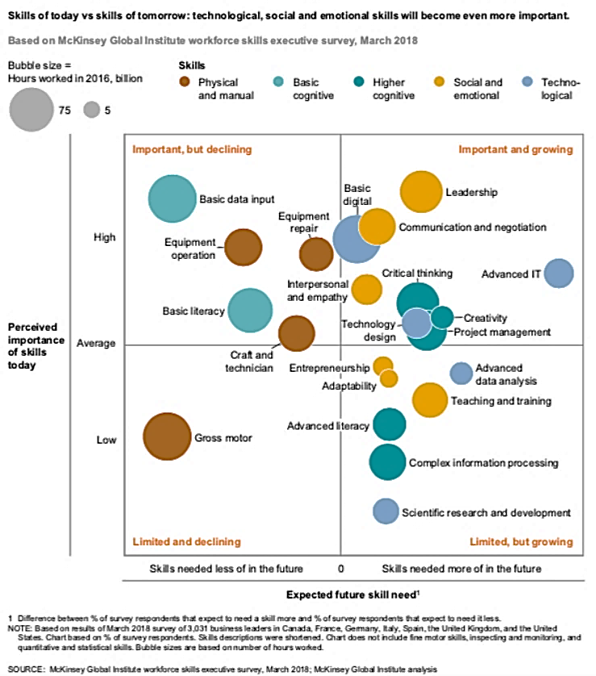
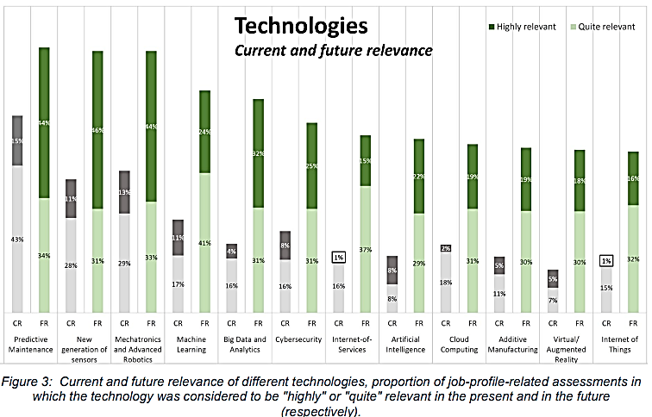
The pivot role of modelling in problem-solving issues in continuous casting of steel: a project clustering experience….
From Blueprint “New Skills Agenda Steel”: Industry-driven sustainable European Steel Skills Agenda and Strategy (ESSA)
Trend so far:
- improved models and time calculations,
- multiphasic approach,
- implementation for process control – AI tools

Slide 4
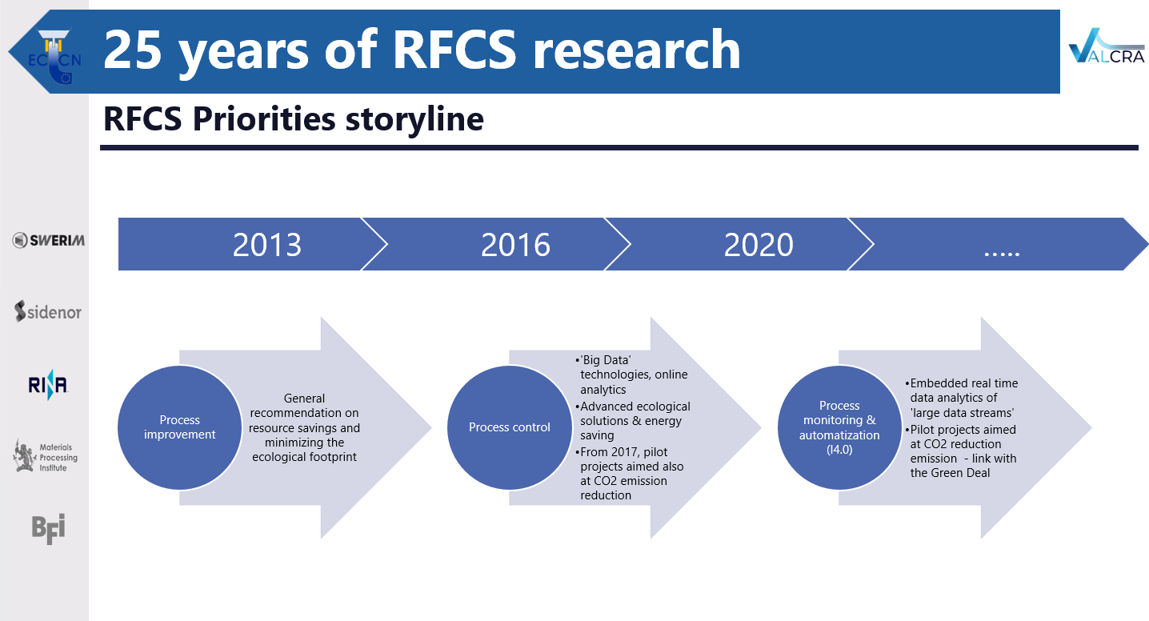
The pivot role of modelling in problem-solving issues in continuous casting of steel: a project clustering experience….
Modelling of continuous casting in Funded projects – RFCS
Modelling is a pillar for problem solving and implementation in tools, well recognized at strategic level (see also the far-sighted storyline of Research Fund of Coal and Steel priorities*)
* from VALCRA Project reports, RFCS-GA No. 84719

Slide 5
The pivot role of modelling in problem-solving issues in continuous casting of steel: a project clustering experience….
Project clustering (= grouping of related projects) offers significant benefits by fostering collaboration, knowledge sharing, and resource optimization.
It allows for a more efficient and effective approach to project management, particularly within large organizations or when dealing with complex, interconnected initiatives.
Project ‘Clustering’*
*https://www.privanova.com/resources/clustering-in-horizon-europe?/clustering-in-horizon-europe#:~:text=Multiplying%20impact%20of%20a%20project,achievement%20of%20their%20key%20impacts

Slide 6

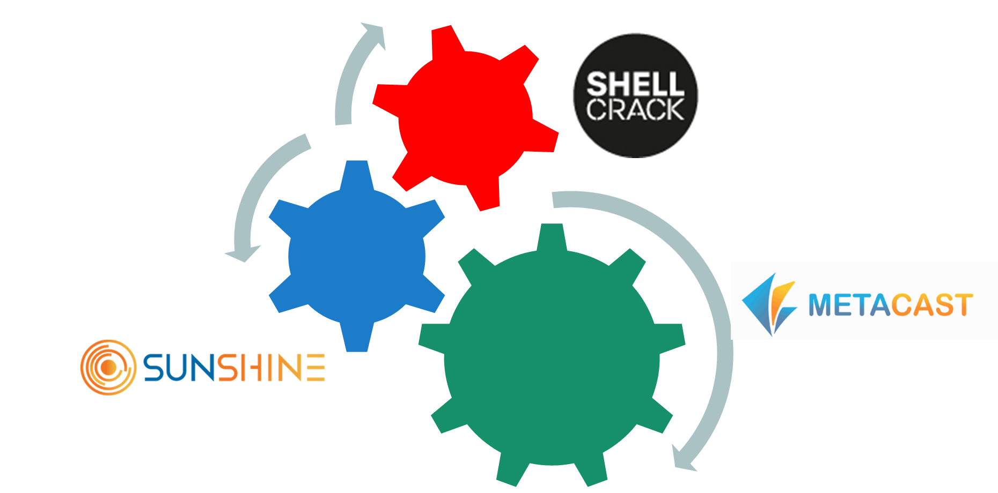
The pivot role of modelling in problem-solving issues in continuous casting of steel: a project clustering experience….
METACAST ⁽¹⁾: towards a common ground for modelling in continuous casting. It leverages insights from past RFCS projects to unlock modelling potential for solving steel industry challenges
SUNSHINE ⁽²⁾ : developing AI-driven models and uses in-line sensors to detect defects early in the casting process, as well as to improve process control and product quality in real time.
SHELL-CRACK ⁽³⁾ : creating robust crack prediction criteria across the casting process, integrating plant trials and smart sensors, material properties and process data to reduce casting defects.
(1)= GA 101155952, (2)= GA 101157885, (3)= GA 101156718

Slide 7

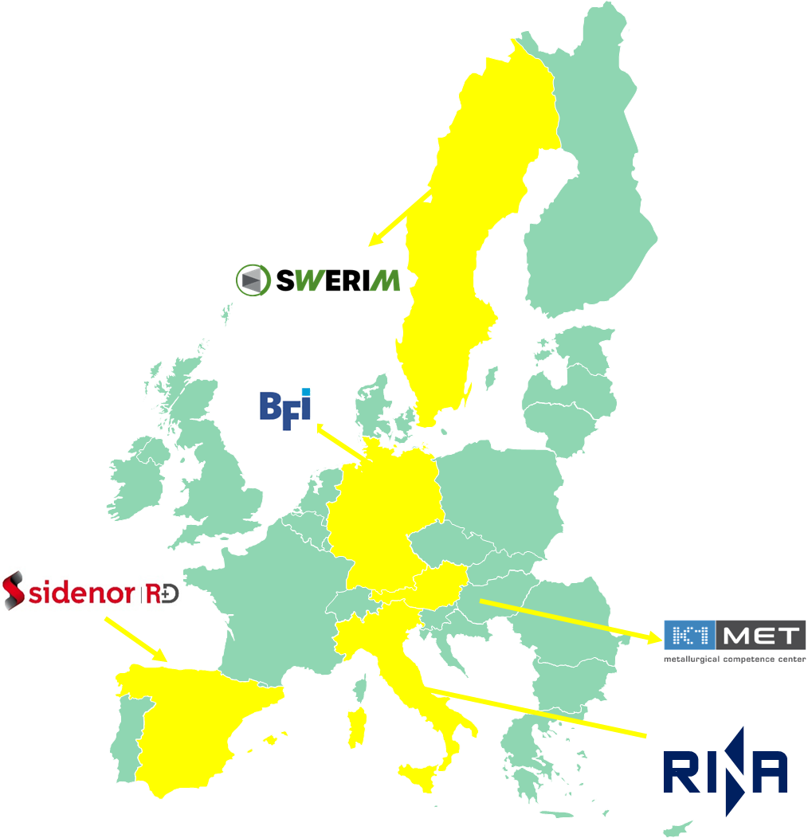

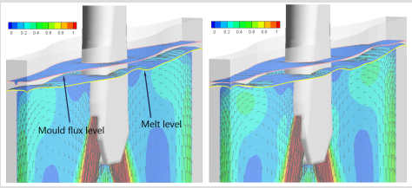
The pivot role of modelling in problem-solving issues in continuous casting of steel: a project clustering experience….
METACAST : Mapping, Educating, Training, Applying models in continuous CASTing
Facing problems solving in continuous casting production (quality, productivity,…) with modelling, to increase knowledge and know how and to enhance process control and AI tools (digital twins)
Issue relevant for all stakeholders: for producers, and to technology providers, for products well integrated with advanced systems (the underutilization of advanced models and AI tools further hinders innovation and optimization)
Main objective(s)
Disseminating and promoting via events/documentation knowledge on modelling in continuous casting from fundamental research activities
Improving the workers' conditions: from safety/environmental workplace to improved skill, by promoting training on advanced tools based on models (e.g., digital twins). To this scope, interviews to stakeholders’ management.
image: S. Rödl, O. Pütz and R. Striedinger, 1st Chinese-German Metallurgy Seminar on Fundamentals of Iron and Steelmaking 18-19. Oct.2004, Beijing

Slide 8









The pivot role of modelling in problem-solving issues in continuous casting of steel: a project clustering experience….
Communication – Dissemination actions
Website LinkedIn Simulation Platform Events organisation (e.g., workshops, webinars) Whitepapers Journal Publications Participation to workshops, conferences, fairs,… Networking with other projects (as in this ‘clustering’ webinar)

Slide 9


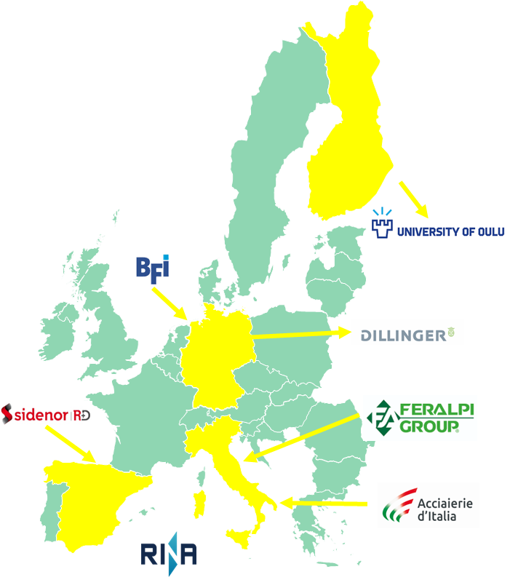
The pivot role of modelling in problem-solving issues in continuous casting of steel: a project clustering experience….
A Modelling Experience coupling modelling, process control and steel quality in continuous casting: SUNSHINE
Non-uniform in-mould solidification in long and flat products can lead to shape defects (e.g., rhomboidity, off-corner depressions…) and/or surface defects (e.g., surface, corner cracks) affecting quality and productivity.
Long products casting suffers improper heat transfer conditions for solidification in the mould and in the secondary cooling zone.
Main project Objectives
Early detection of process conditions leading to these defects.
Identification, with the support of sensors and models, of shape or quality problems in the cast product leading to drawbacks during rolling and/or linked with reheating furnaces/ billets welding problems

Slide 10
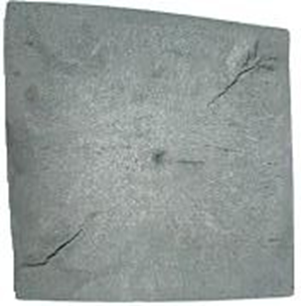
The pivot role of modelling in problem-solving issues in continuous casting of steel: a project clustering experience….
Investigation approach by advanced techniques:
Numerical Modelling and Lab Support: use of integrated numerical codes.
Dedicated Sensoring: Enabling real-time applicable models and AI tools.
From 'knowledge' to 'know-how' approach, tailoring actions for effective problem-solving.
Geometric Defects and Crack Formation: at four industrial plants.
Integrated Approach: Combining casting and rolling processes in a decision support tool for managing the whole process.

Slide 11
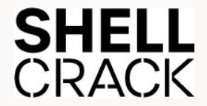
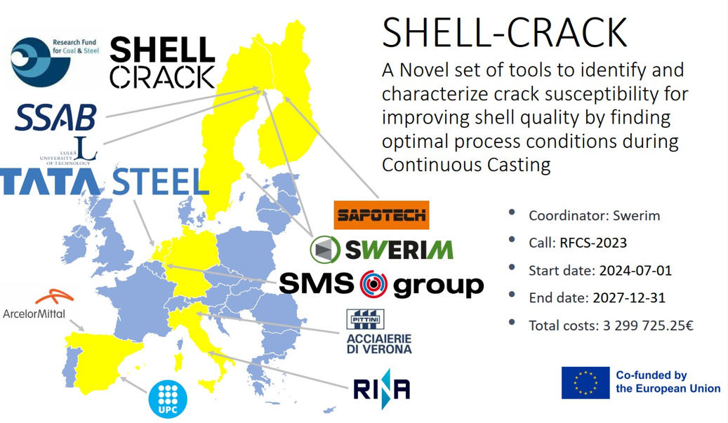
The pivot role of modelling in problem-solving issues in continuous casting of steel: a project clustering experience….
Creating robust crack prediction criteria across the casting process, integrating plant trials and smart sensors, material properties and process data to reduce casting defects.
Dealing with modelling science applied to quality, productivity, safety and innovation.

Slide 12
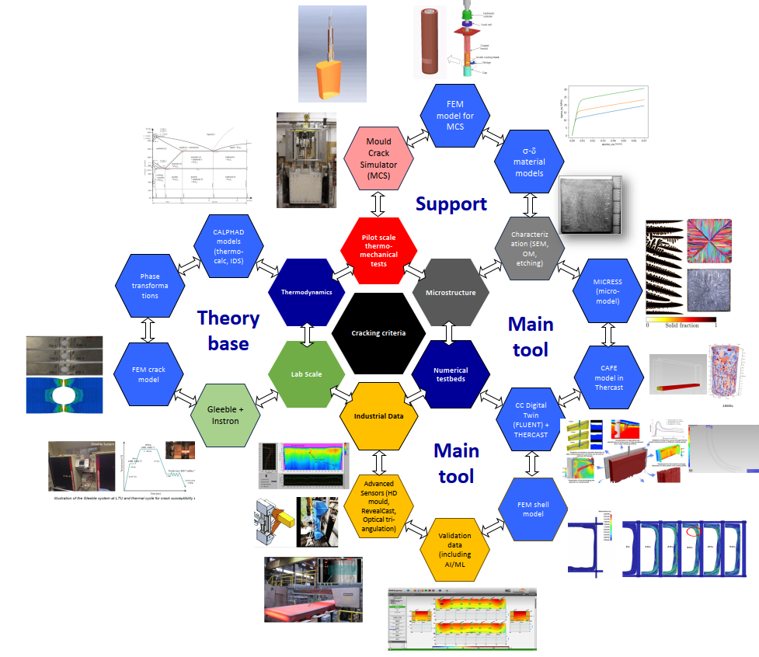
The pivot role of modelling in problem-solving issues in continuous casting of steel: a project clustering experience….
Modelling in Shell Crack is used :
- as main research tool supported by extensive validation
- as support to experimental activities to fill missing info gaps
- as theoretical foundation for describing key physical phenomena

Slide 13
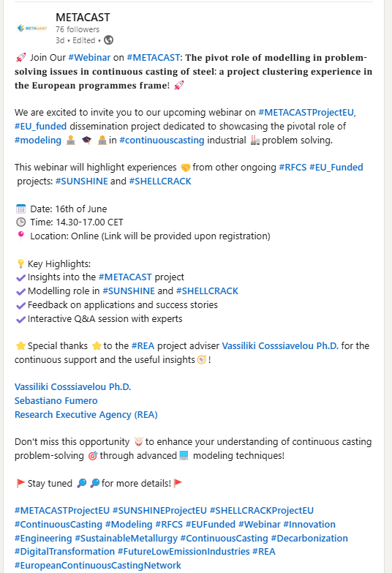
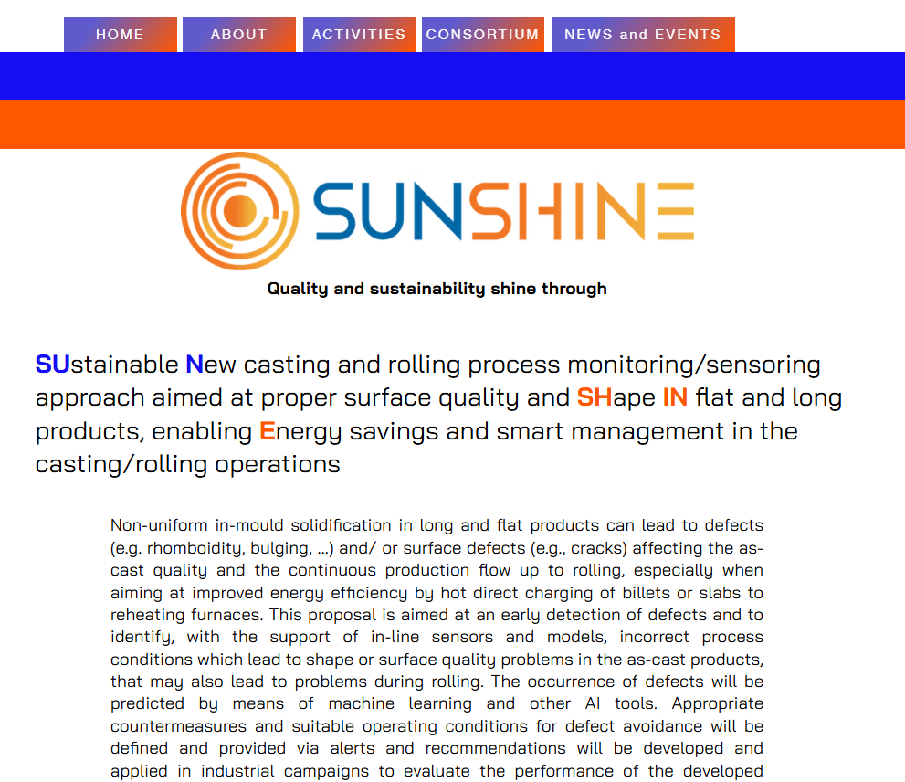
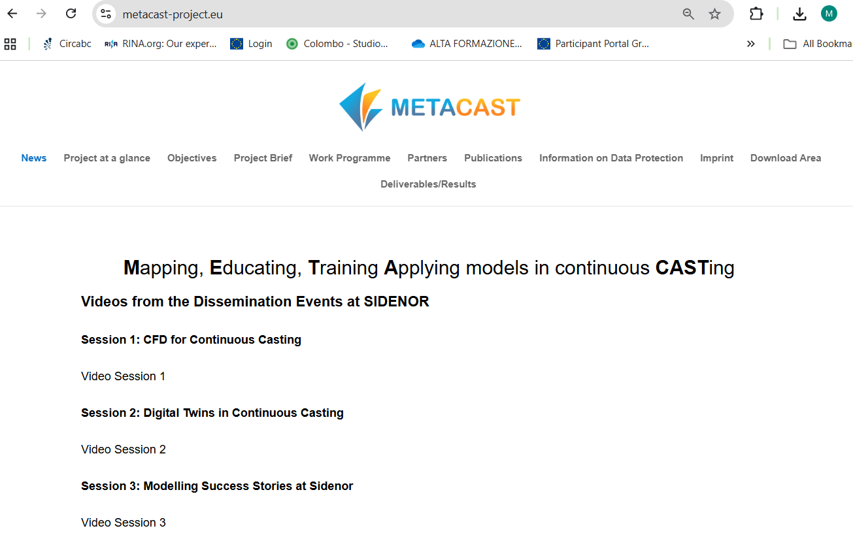
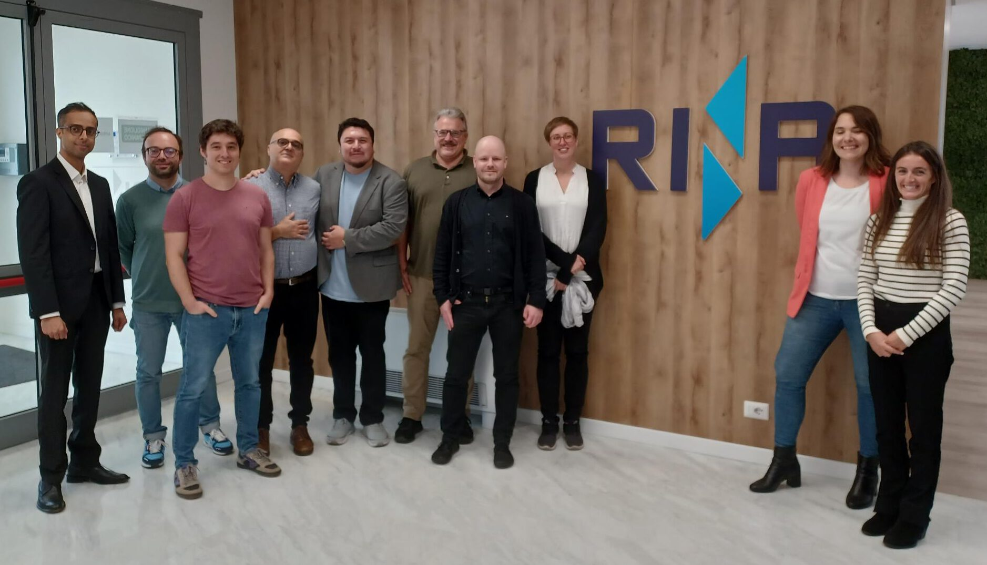
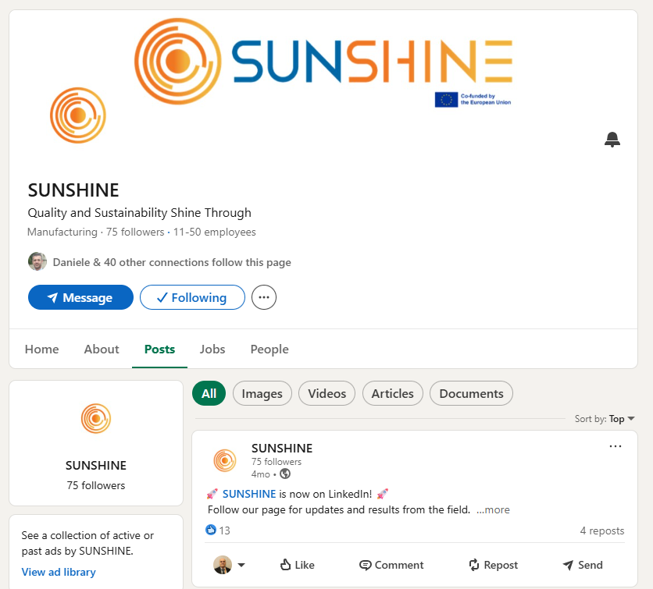
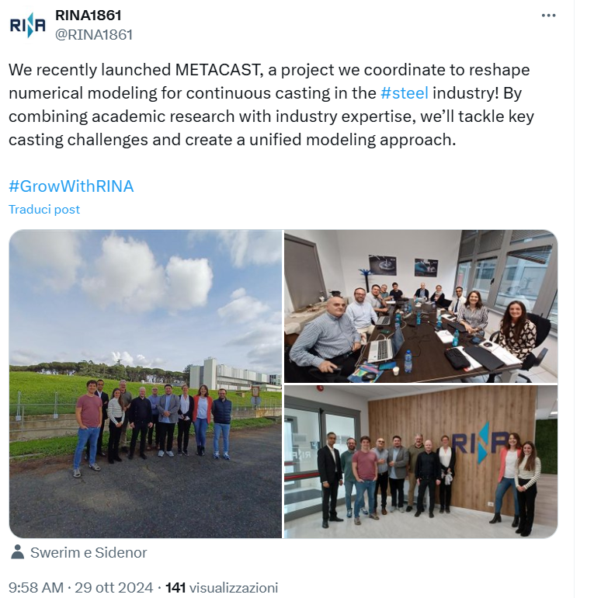
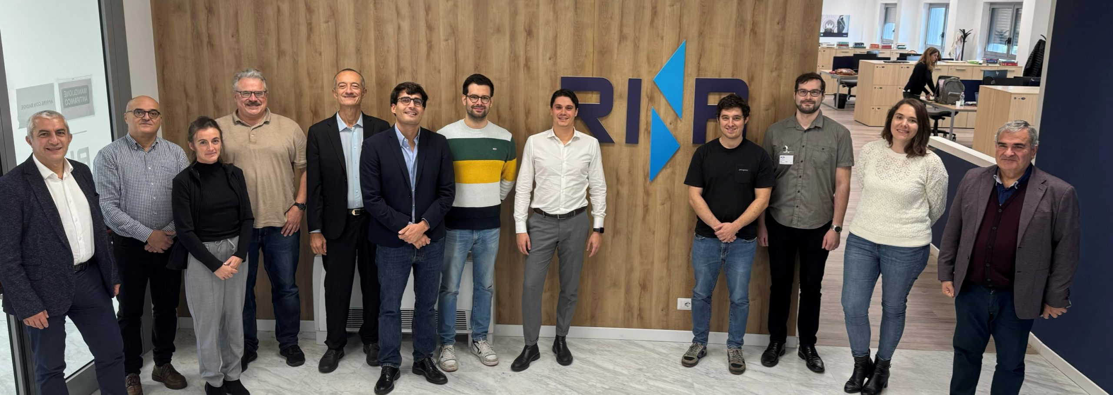
The pivot role of modelling in problem-solving issues in continuous casting of steel: a project clustering experience….
Social media

Slide 14

The pivot role of modelling in problem-solving issues in continuous casting of steel: a project clustering experience….
Modelling & Clustering …

Slide 15


The pivot role of modelling in problem-solving issues in continuous casting of steel: a project clustering experience….
ACKNOWLEDGEMENTS
This study is being carried out with a financial grant from the Research Fund for Coal and Steel of the European Community. The authors would like to thank the EU for supporting the ongoing METACAST project (contract number 101155952), pivoting the clustering initiative, as well for disseminating the main outcomes in the field of casting modelling, and for the mentioned SUNSHINE (contract number 101155952) and SHELL-CRACK Projects.

