Slide 1
Flow and solidification modeling in continuous casting of steel: a European expertise mapping at a glance and positioning at a global level
M. De Santis, E. D’Amanzo, D. Capobianco - RINA-CSM, N. Egido Perez, D. Mier Vasallo – SIDENOR I+D, C. Gruber, A. Atf - K1-MET, K. Marx, M. Koester – BFI,
P. Ramirez Lopez – SWERIM, A. Gotti, Transvalor.

Slide 2

FLOW AND SOLIDIFICATION MODELING IN CONTINUOUS CASTING OF STEEL: A EUROPEAN EXPERTISE MAPPING AT A GLANCE AND POSITIONING AT A GLOBAL LEVEL
A comprehensive review of flow and solidification modeling in continuous casting, developed in the frame of a EU-RFCS* funded project (METACAST*) allowed to map at a glance, approaches and research groups present in Europe, and assess EU expertise positioning in the world.
There is no assessment on Center skills, and RTO-Academia considered in the analysis is not exhaustive but taken as a representative reference
The principal areas of investigation are thermo-fluid dynamics modeling, model implementation strategies, dynamic solidification simulations, validated numerical modeling, and computational fluid dynamics (CFD).
* Research Fund of Coal and Steel (RTCS) contract number 101155952

Slide 3
FLOW AND SOLIDIFICATION MODELING IN CONTINUOUS CASTING OF STEEL: A EUROPEAN EXPERTISE MAPPING AT A GLANCE AND POSITIONING AT A GLOBAL LEVEL
In steel casting, the accurate representation and simulation of critical physical phenomena (e.g. heat transfer, fluid flow, solidification), are fundamental for optimizing the process performance and ensuring the integrity of the final product.
To this end, advanced numerical methodologies, such as the Finite Element Method (FEM), Finite Volume Method (FVM), Cellular Automata (CA), and Phase Field Method (PFM), have been extensively employed.
The aim was establishing a comprehensive and integrative perspective on numerical modeling in continuous casting.

Slide 4
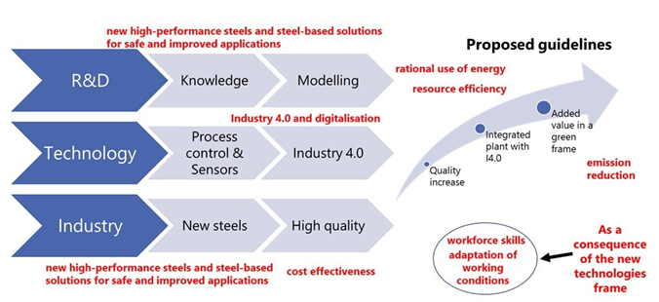
FLOW AND SOLIDIFICATION MODELING IN CONTINUOUS CASTING OF STEEL: A EUROPEAN EXPERTISE MAPPING AT A GLANCE AND POSITIONING AT A GLOBAL LEVEL
Support of funding programmes – Guidelines emerged from stakeholder's feedback in a EU-funded Project (VALCRA)

Slide 5
FLOW AND SOLIDIFICATION MODELING IN CONTINUOUS CASTING OF STEEL: A EUROPEAN EXPERTISE MAPPING AT A GLANCE AND POSITIONING AT A GLOBAL LEVEL
Recent advancements in modeling, involving approach and computing power, are transforming the industrial, and particularly the metallurgy sector, providing more precise tools for quality control and process optimization
In continuous casting of steel, modeling techniques are functional to accurate optimization of the process parameters, such as casting speed, layout geometry and secondary cooling, to minimize surface and internal defects as cracks and segregation.
In general, the modeling approach can involve fundamentals of thermodynamics, solidification kinetics, fluid dynamics highlighting the interplay among heat flow, mass transfer, and thermal stresses.
The integration of advanced technologies (AI, ML) is opening new frontiers in solidification modeling, for greater precision, also in tools integrated with dedicated sensoring for online process and quality control

Slide 6
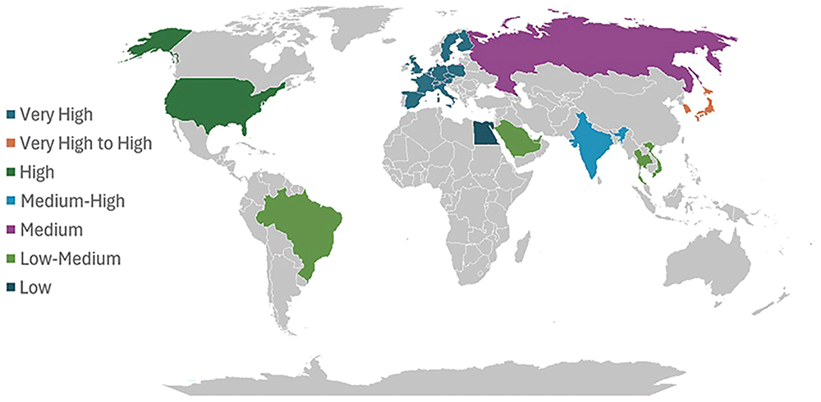
FLOW AND SOLIDIFICATION MODELING IN CONTINUOUS CASTING OF STEEL: A EUROPEAN EXPERTISE MAPPING AT A GLANCE AND POSITIONING AT A GLOBAL LEVEL
Mapping of world skill in steel casting modeling

Slide 7
FLOW AND SOLIDIFICATION MODELING IN CONTINUOUS CASTING OF STEEL: A EUROPEAN EXPERTISE MAPPING AT A GLANCE AND POSITIONING AT A GLOBAL LEVEL
Very High: extensive incorporation of modeling methodologies in academic/industrial domains.
Four relevant aspects fully covered:
significant steel production;
2) presence of worldwide referenced technology providers;
3) academic excellence in the field well matched with industry;
4) funding programs (also encouraging knowledge transfer)
High: Strong scientific output, widespread industrial implementation, among leading stakeholders.
Medium–High: modeling skills by prominent academic institutions with stakeholders' engagement.
Medium: modeling practices often confined to specific organizations/regional clusters.
Low–Medium: low progress in modeling development, mainly reliance on imported technologies.
Low: poor/non-existing modeling frameworks, substantial dependence on external expertise/ techno

Slide 8
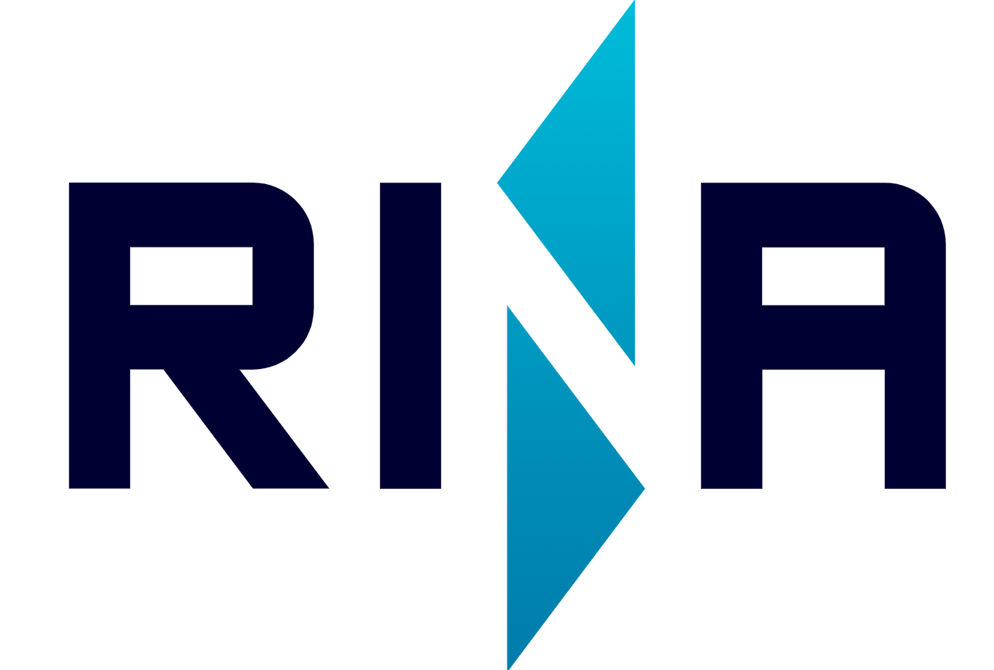

FLOW AND SOLIDIFICATION MODELING IN CONTINUOUS CASTING OF STEEL: A EUROPEAN EXPERTISE MAPPING AT A GLANCE AND POSITIONING AT A GLOBAL LEVEL
Europe | Very High | Strong synergy between academia and industry, high modeling culture. Leading technology providers (e.g., SMS group, Danieli), major producers (e.g., ArcelorMittal, Voestalpine), and prominent research and technology organizations (e.g., CEMEF, Montan University Leoben, KTH, Oulu University, Johannes Keppler University, HZDR, EPFL, RWTH Aachen, CRM Group, and METACAST project partners, RINA-CSM, BFI, K1-MET, SIDENOR, SWERIM) c
East Asia (Japan & South Korea) | Very High | Major steelmakers such as Nippon Steel, JFE, and POSCO with dedicated in-house modeling teams and demonstrate advanced R&D capabilities. Modelling tools routinely employed for process control and optimization, high level of technological integration. (e.g. POSTECH - Research University belonging to POSCO with strong connection with other Korean universities
China | Very High | Vast scale of steel production and substantial investments in digital transformation. Academic output expanding rapidly; however, the degree of modeling integration remains uneven across producers. Academically, modeling is highly developed by Universities such as Northeastern University, University of Science and Technology Beijing and Central South University

Slide 9
FLOW AND SOLIDIFICATION MODELING IN CONTINUOUS CASTING OF STEEL: A EUROPEAN EXPERTISE MAPPING AT A GLANCE AND POSITIONING AT A GLOBAL LEVEL
North America | High | Supported by a strong academic foundation (e.g., Carnegie Mellon University, University of Illinois Urbana-Champaign), national laboratories (e.g., Oak Ridge National Laboratory), and established software platforms (e.g., ANSYS). Industrial adoption of modeling practices varies significantly among companies. Continuous Casting Consortium led formerly by UIUC, recent work by the Purdue Universities (Northwest and Lafayette) as well as Colorado School of Mines is increasing. In Canada, McGill and Toronto Universities are the main providers of modeling activities in Continuous Casting (Prof. B. Thomas). In Canada, Research centers (McMaster University) active in solidification modeling, but industry scale is smaller.
India | Medium–High | Innovation driven by key players such as Tata Steel and JSW. Awareness and application of modeling techniques growing rapidly in both academic and industrial spheres
Latin America | Medium | Modelling applied in both academic and industrial contexts, though the steel sector is relatively small and often reliant on imported technologies. Main modeling activities are carried out in Mexico (CINVESTAV, IPN and UNAM), as well as Argentina (Center for Industrial Research, FUDETEC and CIMEC) and Brazil (Federal Fluminense University and Federal University of Minas Gerais), e.g.: papers from ABM (Associação Brasileira de Metalurgia) conferences.

Slide 10
FLOW AND SOLIDIFICATION MODELING IN CONTINUOUS CASTING OF STEEL: A EUROPEAN EXPERTISE MAPPING AT A GLANCE AND POSITIONING AT A GLOBAL LEVEL
South-East Asia and Middle East | Low–Medium | Domestic development of modeling capabilities limited. Primarily act as end-users of technologies developed in China, Japan, and Europe (e.g.: SEAISI -South East Asia Iron and Steel Institute) industry outlook reports.
Africa | Low | Characterized by a minimal industrial base and negligible domestic modeling R&D. These regions are largely dependent on foreign technologies and expertise. South Africa has some academic metallurgy programs (University of Pretoria, Wits) but limited industrial modeling.

Slide 11
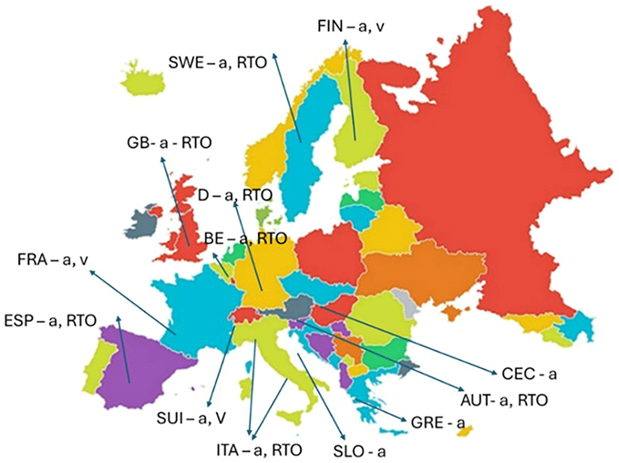
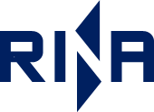
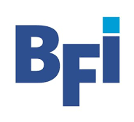
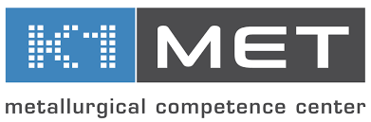
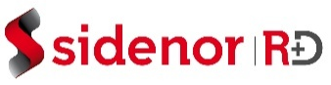

FLOW AND SOLIDIFICATION MODELING IN CONTINUOUS CASTING OF STEEL: A EUROPEAN EXPERTISE MAPPING AT A GLANCE AND POSITIONING AT A GLOBAL LEVEL
Geographic Distribution of European casting modeling expertise.
Legenda: a = academic frame; v = code developers; RTO = research centers.
Partners in METACAST with well recognized high-skill in the field:
RINA-CSM
BFI
K1-MET
SIDENOR
SWERIM

Slide 12
FLOW AND SOLIDIFICATION MODELING IN CONTINUOUS CASTING OF STEEL: A EUROPEAN EXPERTISE MAPPING AT A GLANCE AND POSITIONING AT A GLOBAL LEVEL
CONCLUSIONS
In recent years, there has been a noticeable pivot from fundamental research toward the deployment of models in industrial practice. The EU funding programmes, e.g., Research Fund for Coal and Steel (RFCS), played a relevant role, by contributing significantly to consolidate stakeholders' involvement toward an improved modelling-oriented research culture.
The evolution of modeling applications has progressed from process enhancement to advanced control, and more recently, to real-time monitoring and automation. Furthermore, the integration of modeling with digital technologies is expected to drive demand for a more highly skilled workforce.
In this context, the precision in simulating physical phenomena and the deepening of process knowledge have become increasingly crucial, supporting efficient production management, and strengthening the global competitiveness of European actors in the steel sector

Slide 13

FLOW AND SOLIDIFICATION MODELING IN CONTINUOUS CASTING OF STEEL: A EUROPEAN EXPERTISE MAPPING AT A GLANCE AND POSITIONING AT A GLOBAL LEVEL
ACKNOWLEDGEMENTS
This study was carried out with a financial grant from the Research Fund for Coal and Steel of the European Community. The authors would like to thank the EU for supporting the ongoing METACAST project (contract number 101155952) for disseminating the main outcomes in the field of casting modeling.

