Slide 1
Casting Modelling: From Code Development to Stakeholder Support
The point of view of a software publisher

Slide 2
Agenda
Introducing Transvalor
Which CC stakeholders use simulation and why
CC stakeholders' expectations about a process simulation software
A case study about the role of a software publisher: addressing internal quality in CC with EMS
Definition of the problem
Electromagnetic simulations with Thercast®
The Gordian knot of applying EMS (device & simulation)
Conclusions

Slide 3
Introduction

Slide 4
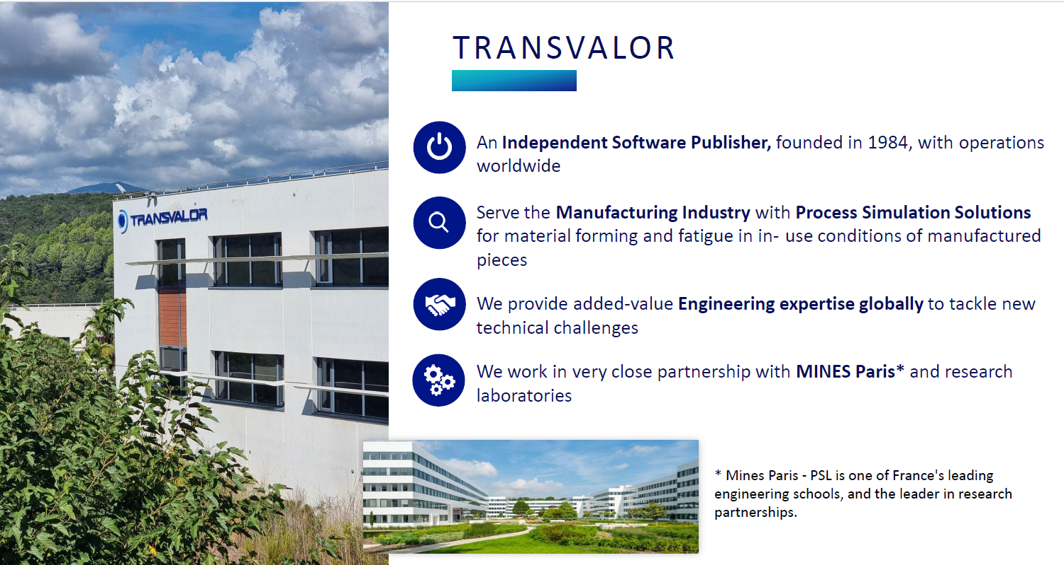
Introducing Transvalor

Slide 5
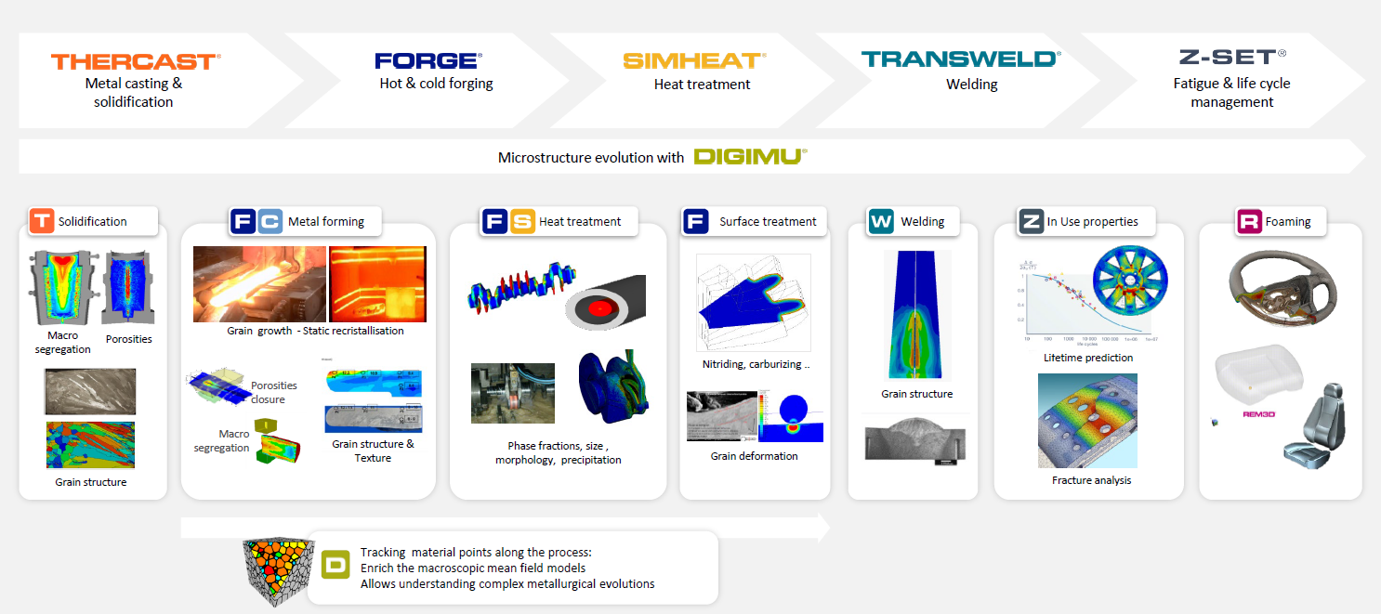
Transvalor’s digital supply chain

Slide 6
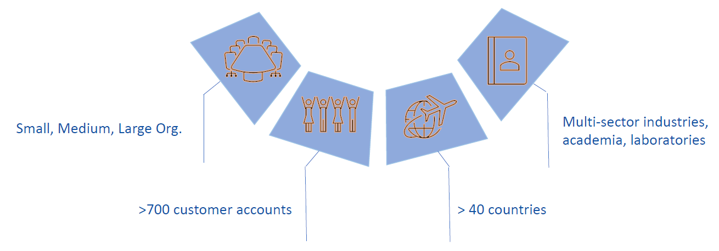
Transvalor customers

Slide 7
Which CC stakeholders use simulation and why
Numerical simulation of CC
R&D Groups or Organisations
Technology provider
Steelmaking PROCESS ENGINEERS
Complex interaction of phenomena (multiphysics/multiscale)
Free surface behaviour in a multiphase approach
Particle tracking
Electromagnetic effects
Microstructure develompent
Advanced material behaviour in solidification (cracking criteria)
Interoperability with in-house models in a digital twin approach
Design of:
Melting furnaces
Tundish
Mould (taper)
EMS
SEN
Machine layout
Secondary cooling
Validation/improvement of online control system (Level 2)
Improve productivity
Cast new steels
Reduce defects
Cracks
Segregation
Manage transients in the process

Slide 8
CC stakeholders' expectations
Numerical simulation of CC
R&D Groups or Organisations
Equipment designers
Steelmaking (e.g. PROCESS ENGINEERS)
Flexibility in model setup
Multiphysics
Strong meshing capabilities
Access to user variables/routines
Detailed technical documentation
Cooperation/interaction with our experts
High performance on parallel computation
Short CPU times
Ease of use (with limited knowledge of numerical modelling)
Guidance on CC process by our experts
Validated material data
Short CPU times
Quick answers from support
Fast CC machine digitalization process
Integration with CAD systems
Strong meshing capabilities
Validated criteria for material resistance
Automated parametric studies
Efficient Optimisation tools
Automated analysis of results/reports
Short CPU times

Slide 9
The role of a software editor: A case study

Slide 10
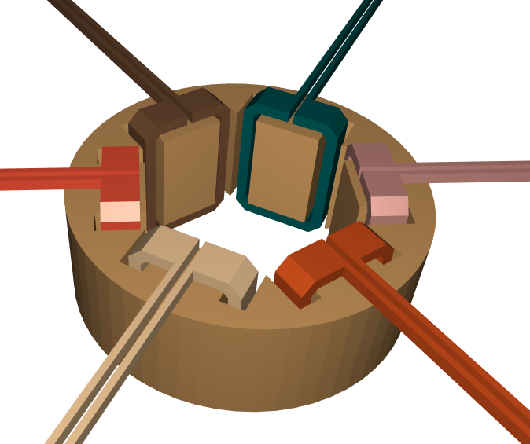
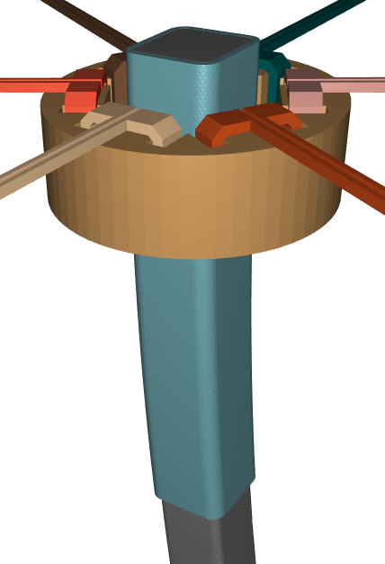
Internal quality problem. Solution with EMS
Steelmakers address issues of internal quality by application of stirrers and brakes in the CC machine
Optimal tuning of the EMS units requires awareness and quantification of impact of the EMS parameters on final solidification structure
The software editor main role is to provide the necessary simulation tool.
Transvalor developed the Matelec solver coupled with Thercast.
However, the availability of a simulation tool is not enough for its full exploitation and complete solution of the problem
Before addressing this matter, let’s have a look at the solver
2
3
1
4
5
6
Example of stirrer model in Thercast

Slide 11
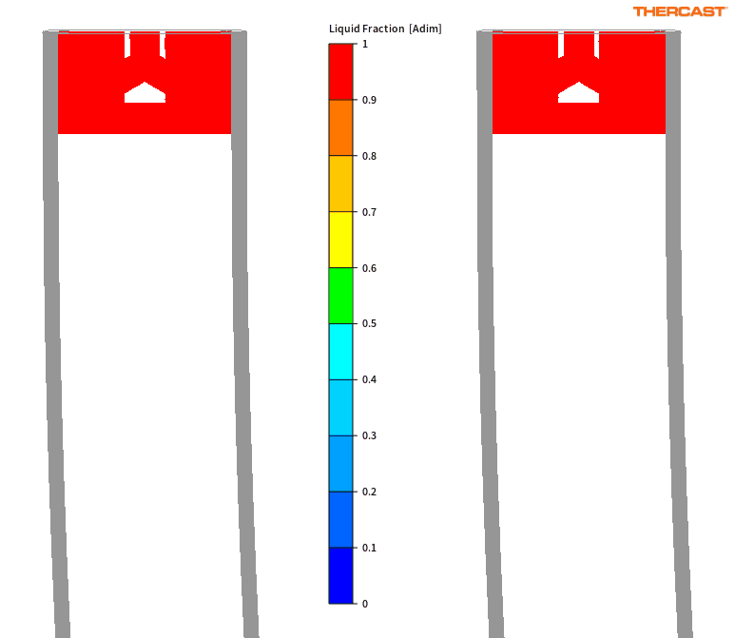
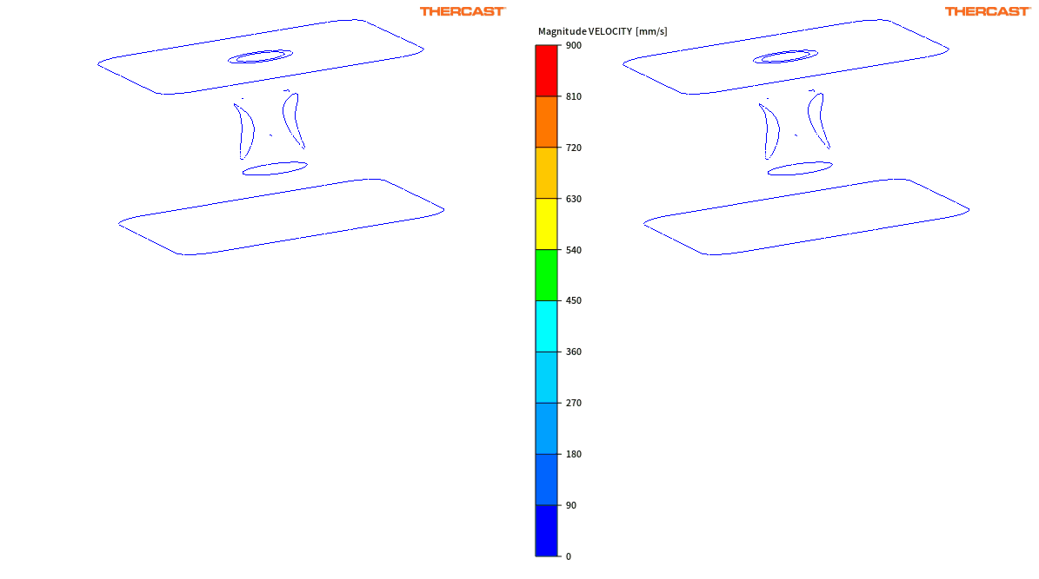
1. Fully coupled MHD+Thermal Simulations
Example of results with THERCAST 3.0 from an “industrial-like” case
No Stirring
Stirring
No Stirring
Stirring

Slide 12
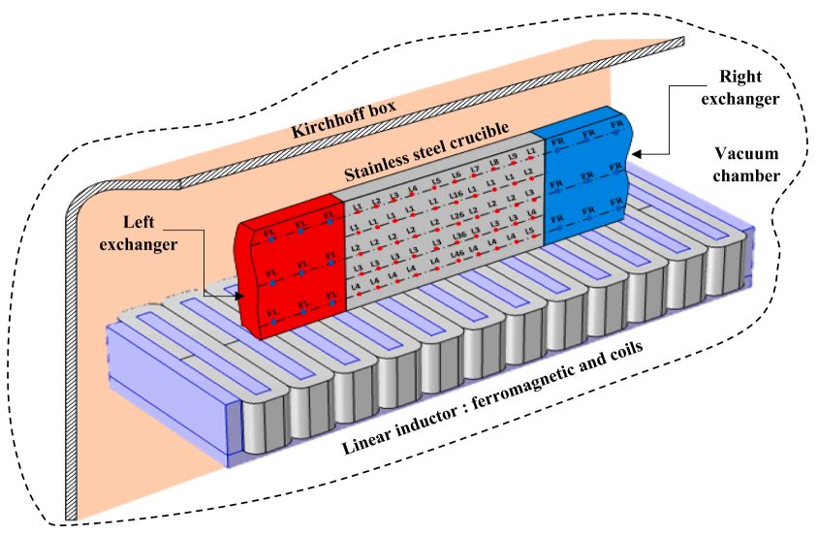
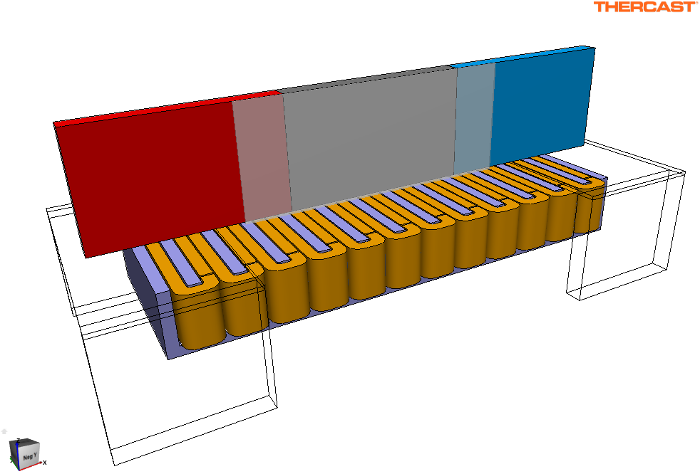
2. Application to a benchmark experiment
Modeling of stirring machine “inspired by” the AFRODITE experiment with Sn-10wt%Pb
Work presented at UIE2024 Conference on electrification of industrial thermal and manufacturing processes
This “quasi-2D” experiment reproduces a directional solidification of a binary alloy under controlled gradient and solid front velocity
Wall of the crucible (transparent grey)
Right exchanger
Melt
Left exchanger
[ Wang et al., C.R. Mecanique, 2007 ]
Left heat exchanger
Sn-10wt.%Pb alloy sample
Thermocouples position matrix
Stainless steel crucible
Right heat exchanger
Linear motor
Steel supports
Inductors
Ferromagnetic core
[ Khelfi et al., JCG, 2022 ]
Schematic representation of AFRODITE experimental setup
Numerical modeling in THERCAST®

Slide 13
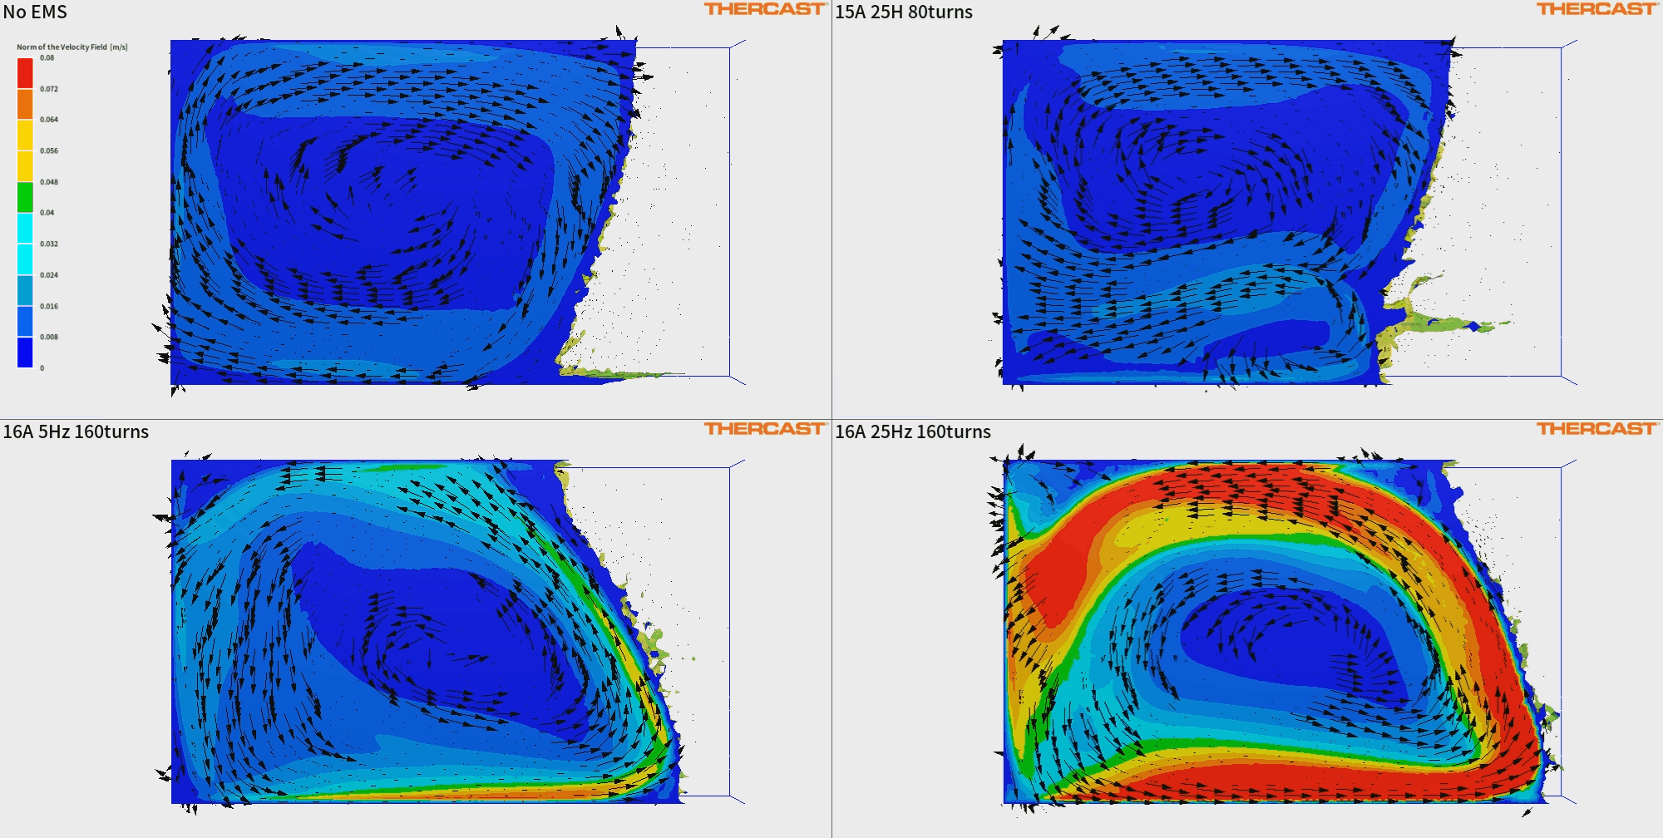
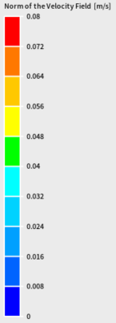
Simulation results: velocity field in fluid domain
Parametric study on source current frequency and amplitude
Comparison with reference case (no EMS), varying the stirrer parameters
Velocity vectors and maps in liquid domain (liquid fraction [0.99,1]) over half-cutting plane of axis y

Slide 14
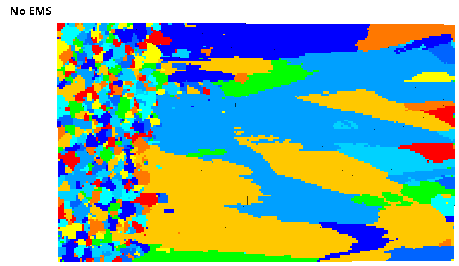
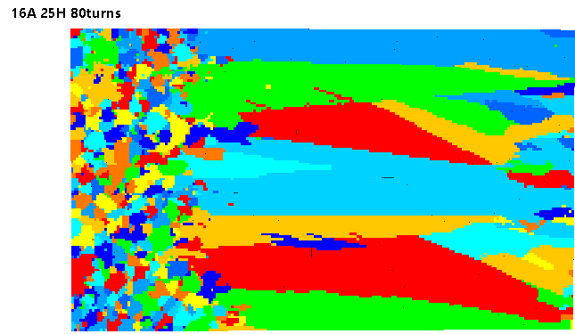
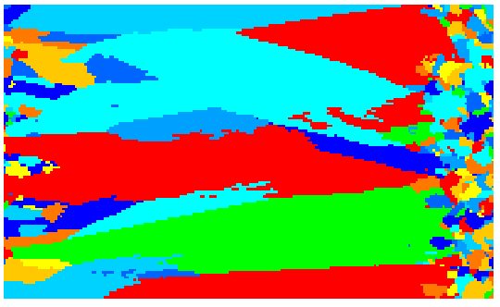
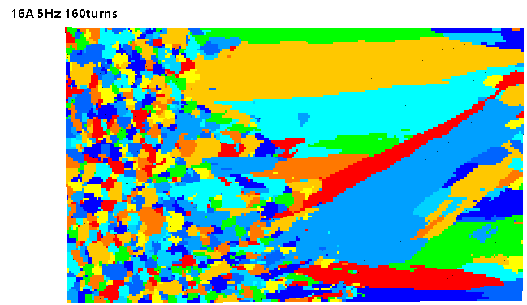
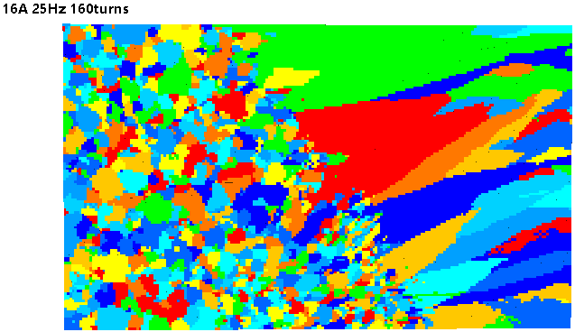
Simulation results: microstructure at end of solidification with CAFE
Parametric study on source current frequency and amplitude
Comparison with reference case (no EMS), varying the stirrer parameters, and with purely thermal case
Only thermal computation (no fluid flow)

Slide 15
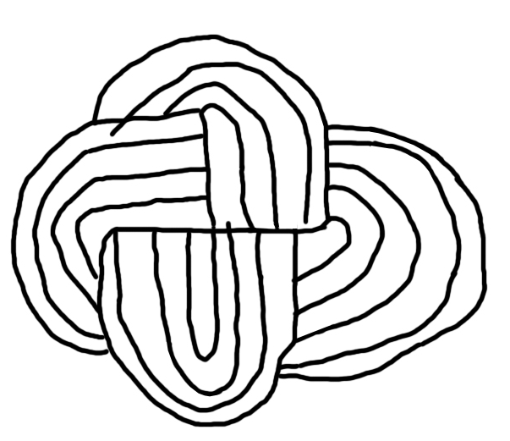
The Gordian Knot of applying EMS simulation
TECHNOLOGY PROVIDER
STEELMAKER
SOFTWARE EDITOR
The legend of the Gordian knot tells of an intricate knot tied by King Gordias of Phrygia, which was said to be impossible to untie.
A prophecy declared that whoever could loosen the knot would rule Asia.
When Alexander the Great arrived in Phrygia, he encountered the knot and, unable to untie it through traditional means, famously cut through it with his sword.
This act, though not the intended method, fulfilled the prophecy as Alexander went on to conquer much of Asia.
Graffiti with a four-ribboned Gordian knot in the Abbey of Valvisciolo in Sermoneta (Latina, Latium, Italy)

Slide 16
Interdependencies among stakeholders: sharing tools and data
TECHNOLOGY PROVIDER
STEELMAKER
SOFTWARE EDITOR
Solver development | ☹
Numerical implementation | ☹
Information about equipment layout | ☺
Information about process conditions & final microstructure | ☹
References on industrial cases | 😐
Solver development: Write equations Define boundary conditions Identify material properties | ☺
Numerical implementation: Solution of equations Meshing techniques Stabilization techniques Parallelization Looping | ☺
Information about equipment layout | ☹
Information about process conditions & final microstructure | ☹
References on industrial cases | 😐
Solver development | ☹
Numerical implementation | ☹
Information about equipment layout | ☹
Information about process conditions & final microstructure | ☺
References on industrial cases | 😐

Slide 17
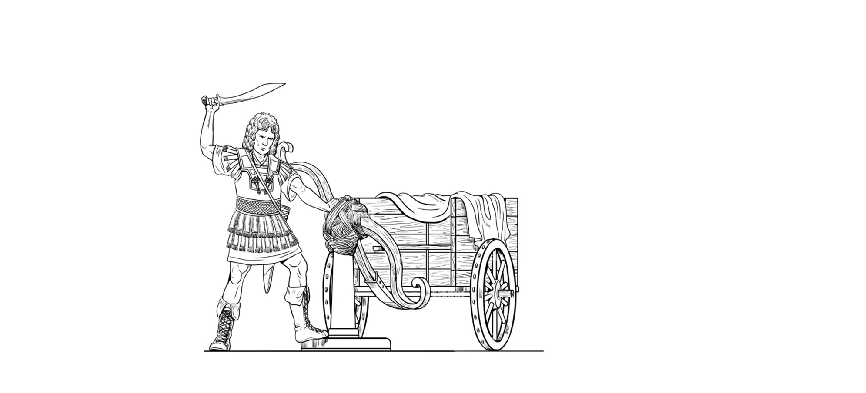
How to untie the knot…. without cutting it
The software editor is an independent third party who provides the key tool enabling full exploitation of the EMS device by the steelmaker, while protecting IP of the equipment designer about device layout
Solidification
Fluid flow in liquid metal
Shape of solid shell
Shape of liquid pool
Solidification structure
Segregation
Caster layout & parameters
THERCAST
Steelmaker
EMS Current intensity & frequency
Lorentz force, temperature, metal velocity
MATELEC
DIGITAL BLACK BOX
To protect information
EMS layout
The software editor acts as proactive bridge between the plant technology and problem solving in the process
DLL or other hardcoded,
compiled scripts
EQUIPMENT DESIGNER
EMS layout

Slide 18
Conclusions

Slide 19
A further step: sharing the knowledge…
…to achieve stronger accountability in the steelmaking community
TECHNOLOGY PROVIDER
Discloses information on device layout
STEELMAKER
Discloses process information, & experimental data
SOFTWARE EDITOR
Provides simulation tools and expertise
GAIN: Design supported by validated simulation tools
Common projects
+
NDA agreement
GAIN: Robust references thanks industrial validation cases
GAIN: Scientific approach to process management (full control of caster & EMS)

Slide 20
Conclusions
Awareness about modelling in the European steelmaking industry is the highest in the world, thanks mainly to RFCS projects, and now it is boosted by dissemination activities
Now it is time for full industrial and R&D exploitation, as digital twins fully representing the reality
The possibility of effective application of modelling and simulation tools relies very much on availability of data: material properties, information about plant layout, process parameters, measurements on the field, microstructure/defect information
Collaborative work among the different stakeholders in steelmaking is key to be competitive

Slide 21
Thank you very much for your attention!

