Slide 1


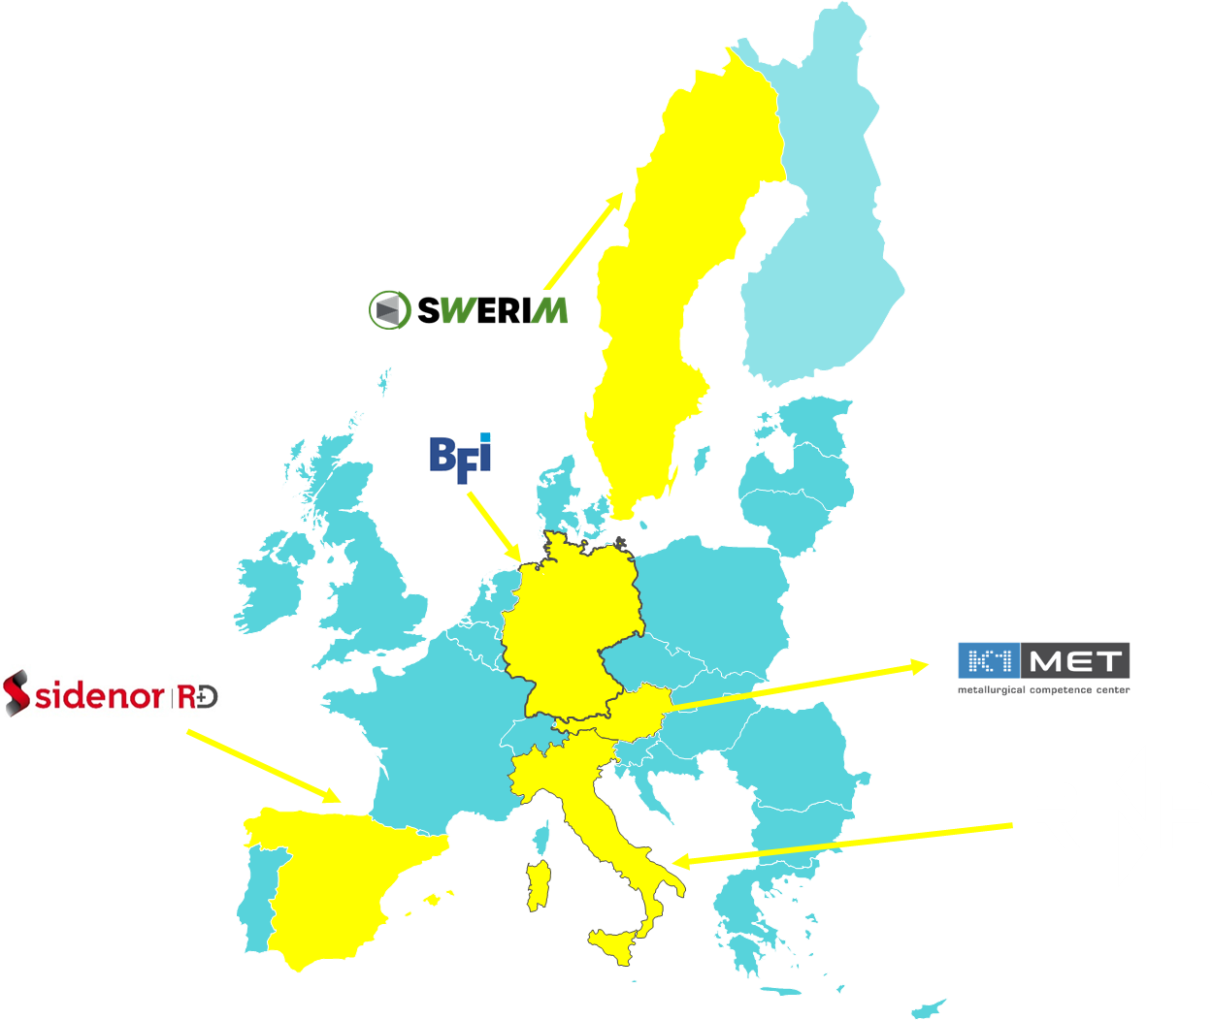
METACAST
Mapping, Educating, Training, Applying models in continuous CASTing
WEBINAR
The pivot role of modelling in problem-solving issues in continuous casting of steel:
a project clustering experience in the European programmes frame
Michele De Santis (RINA-CSM)

Slide 2
METACAST
Mapping, Educating, Training, Applying models in continuous CASTing
Welcome and Introduction: clustering for impact: focus on modelling
Michele De Santis (RINA-CSM)
Disclaimer: Views and opinions expressed are however those of the author(s) only and do not necessarily reflect those of EU/REA, which cannot can be held responsible for them.

Slide 3
‘Clustering’*
Project clustering (= grouping of related projects) offers significant benefits by fostering collaboration, knowledge sharing, and resource optimization.
It allows for a more efficient and effective approach to project management, particularly within large organizations or when dealing with complex, interconnected initiatives.
*https://www.privanova.com/resources/clustering-in-horizon-europe?/clustering-in-horizon-europe#:~:text=Multiplying%20impact%20of%20a%20project,achievement%20of%20their%20key%20impacts

Slide 4
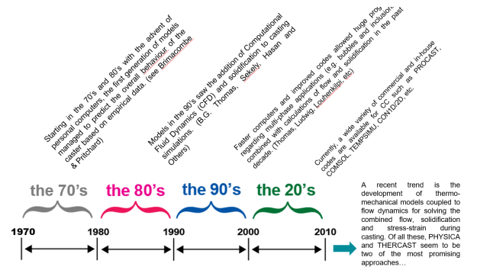
Modelling Importance
Starting point: the huge modelling potential achieved through RFCS projects to solve casting challenges in the European steel industry.
Recent advances on modelling disseminated in 3 areas:
Fundamental Research
Industrial Applications
Decision-Making
Trend so far:
improved models and time calculations,
Multiphasic approach,
Implementation for process control – AI tools

Slide 5
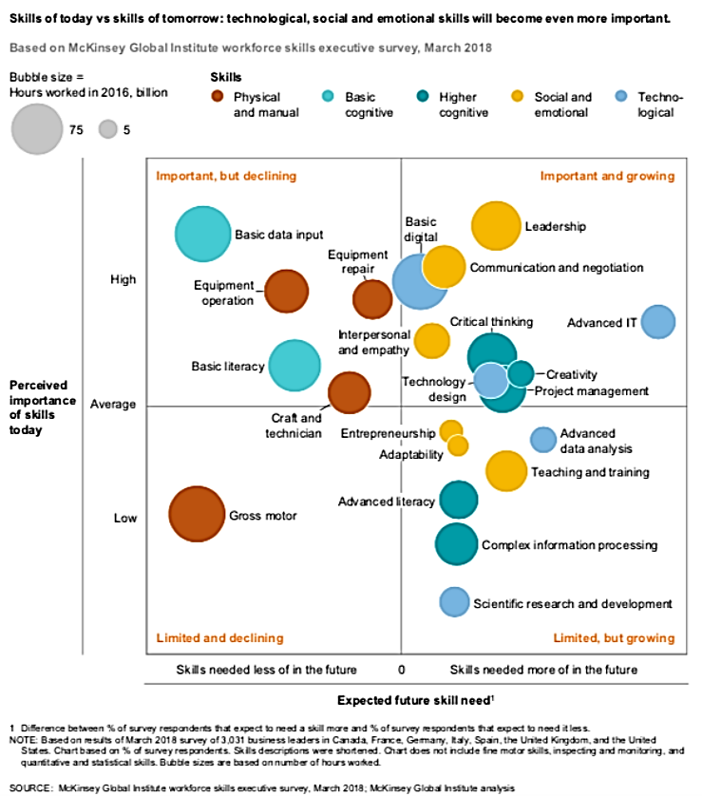
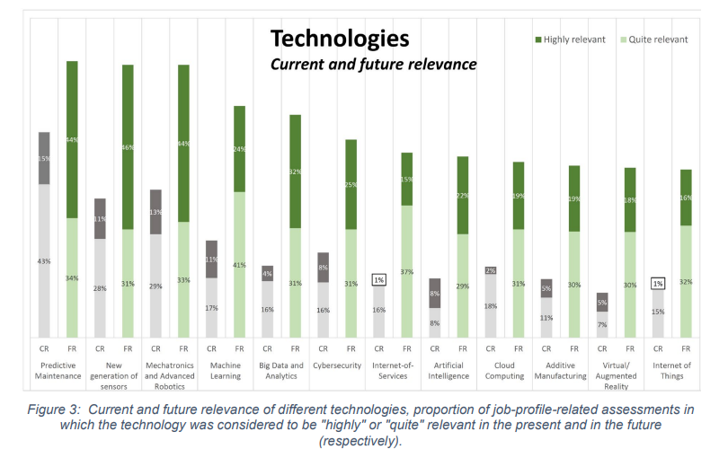
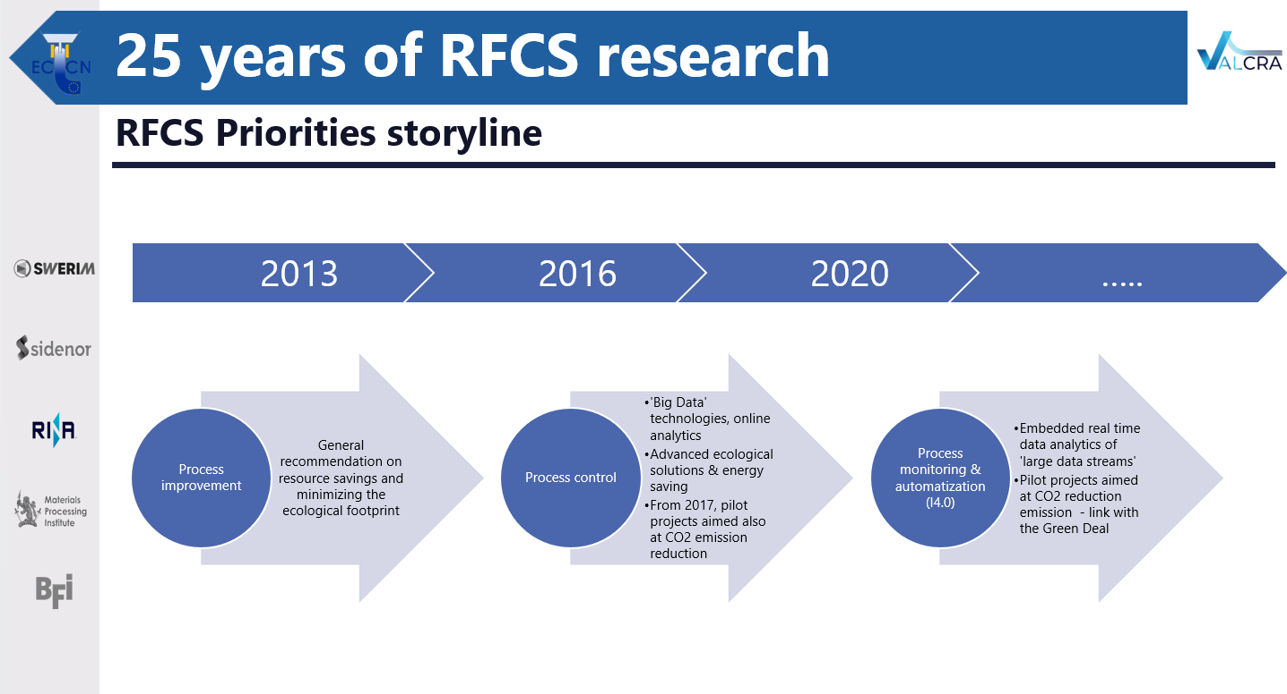
Trends and skills
… in line with the need of improved skill (also boosted by open training/dissemination events and targeting appropriate decision makers including researchers and managers) …
… as modelling is a pillar for problem solving and implementation in tools (see also the far-sighted storyline of RFCS priorities*)
* VALCRA RFCS-GA No. 84719
From Blueprint “New Skills Agenda Steel”: Industry-driven sustainable European Steel Skills Agenda and Strategy (ESSA)

Slide 6


Steel casting: current projects

Slide 7
Steel casting: current projects
copyright JKU-ISW
The webinar will explore three groundbreaking EU-funded projects on the world of continuous casting of steel:
METACAST (GA 101155952): A dissemination project coordinated by RINA-CSM; it builds a common ground for modelling in continuous casting. It leverages insights from past RFCS projects to unlock modelling potential for solving steel industry challenges
SUNSHINE (GA 101157885): Coordinated by RINA-CSM, it develops AI-driven models and uses in-line sensors to detect defects early in the casting process. It aims to improve process control and product quality in real time.
SHELL-CRACK (GA 101156718): Led by SWERIM, the project creates robust crack prediction criteria across the casting process. Using plant trials and smart sensors, it integrates material properties and process data to reduce casting defects.
They deal with modelling science applied to quality, productivity, safety and innovation.

Slide 8
Steel casting: current projects
copyright JKU-ISW
The webinar will explore three groundbreaking EU-funded projects on the world of continuous casting of steel:
METACAST (GA 101155952): A dissemination project coordinated by RINA-CSM; it builds a common ground for modelling in continuous casting. It leverages insights from past RFCS projects to unlock modelling potential for solving steel industry challenges
SUNSHINE (GA 101157885): Coordinated by RINA-CSM, it develops AI-driven models and uses in-line sensors to detect defects early in the casting process. It aims to improve process control and product quality in real time.
SHELL-CRACK (GA 101156718): Led by SWERIM, the project creates robust crack prediction criteria across the casting process. Using plant trials and smart sensors, it integrates material properties and process data to reduce casting defects.
They deal with modelling science applied to quality, productivity, safety and innovation.

Slide 9
Steel casting: current projects
copyright JKU-ISW
The webinar will explore three groundbreaking EU-funded projects on the world of continuous casting of steel:
METACAST (GA 101155952): A dissemination project coordinated by RINA-CSM; it builds a common ground for modelling in continuous casting. It leverages insights from past RFCS projects to unlock modelling potential for solving steel industry challenges
SUNSHINE (GA 101157885): Coordinated by RINA-CSM, it develops AI-driven models and uses in-line sensors to detect defects early in the casting process. It aims to improve process control and product quality in real time.
SHELL-CRACK (GA 101156718): Led by SWERIM, the project creates robust crack prediction criteria across the casting process. Using plant trials and smart sensors, it integrates material properties and process data to reduce casting defects.
They deal with modelling science applied to quality, productivity, safety and innovation.

Slide 10
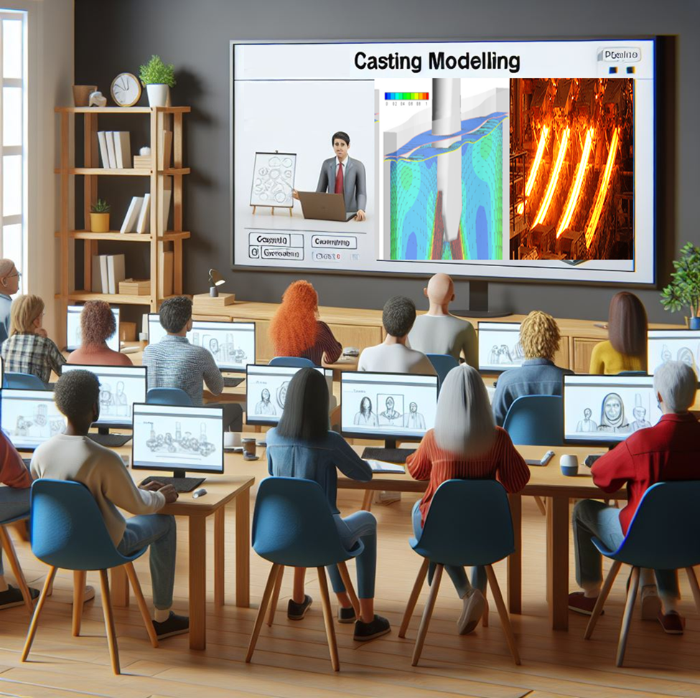

Communication, dissemination, exploitation
The webinar scope and impact will be strengthened by a special insight from the EU on the powerful role of dissemination and exploitation the project clustering can take benefit from as a booster
Towards realizing a success story

Slide 11



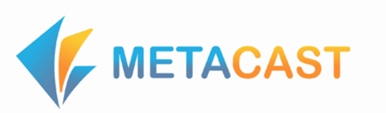
Expected webinar outcome
Providing insight on the importance of modelling as tool functional to:
  Industrial problem solving
  AI/ML feeding for process digitalisation
  improved workers’ skill vs the current challenges

Slide 12
Agenda
1 | Welcome and Introduction - (Michele De Santis – RINA-CSM)
2 | METACAST: Dissemination of a modelling Approach – (Michele De Santis – RINA-CSM)- Q/A
3 | A Modelling Experience coupling modelling, process control and steel quality in continuous casting: SUNSHINE (Orlando Di Pietro– RINA-CSM) - Q/A
4 | Advanced techniques supported by solidification and microstructure modelling in facing cast defect occurrence: SHELL CRACK – (Pavel Ramirez Lopez – SWERIM)
5 | Casting Modelling support of code developers to stakeholders: experiences and issues (Arianna Gotti – Transvalor) - Q/A
6 | Communication and Dissemination: Clustering as projects booster. Insights from EU Commission (Elsa Papadopoulou - European Commission - REA.B1) – Q/A
7 | Open discussion with audience on modelling role in continuous casting problem solving and current efforts by stakeholders (experiences, lessons learnt, success stories)
8 | Wrap-up/Conclusions

Slide 13
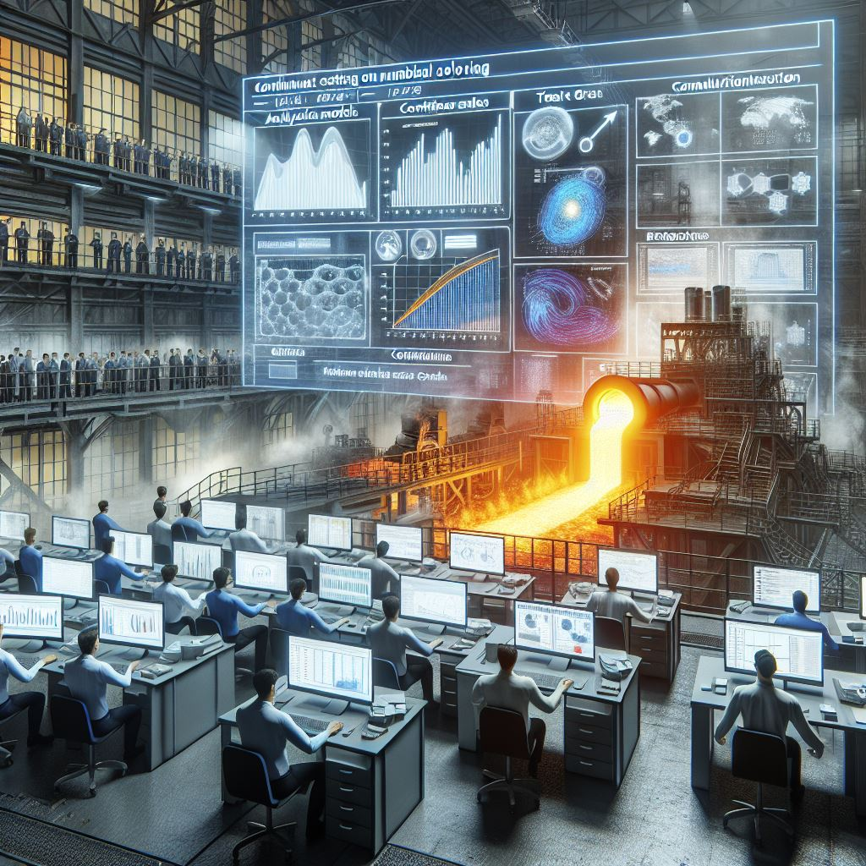
Have a fruitful webinar …
And see you at the Q/A panel for a fruitful discussion!

