Slide 1

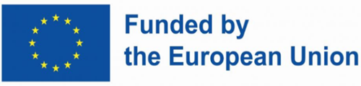
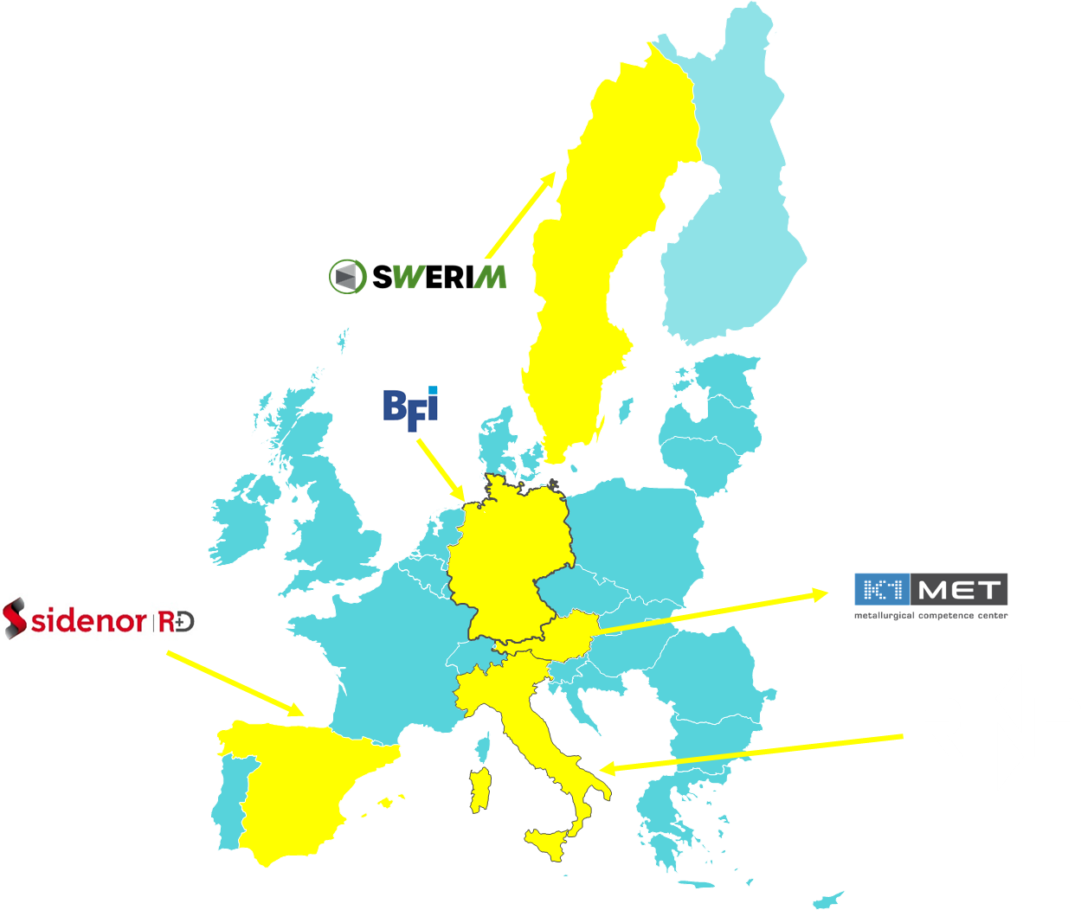
METACAST
Mapping, Educating, Training, Applying models in continuous CASTing
WEBINAR
The pivot role of modelling in problem-solving issues in continuous casting of steel:
a project clustering experience in the European programmes frame
Michele De Santis (RINA-CSM)

Slide 2

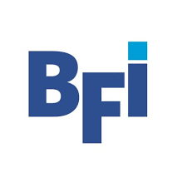
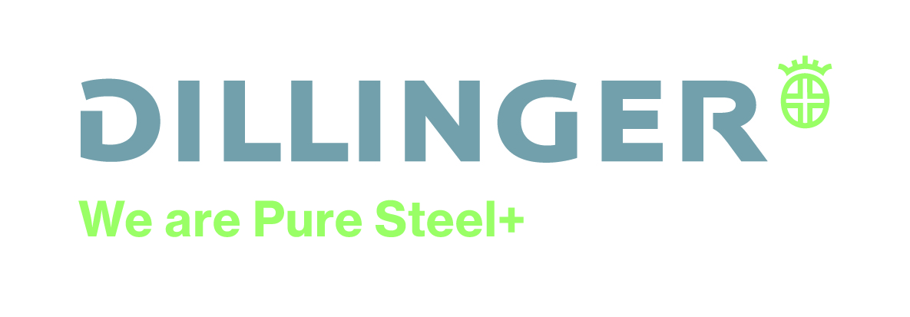
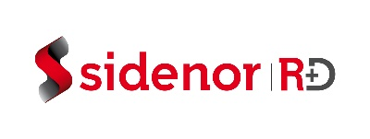

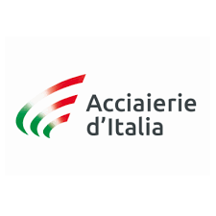
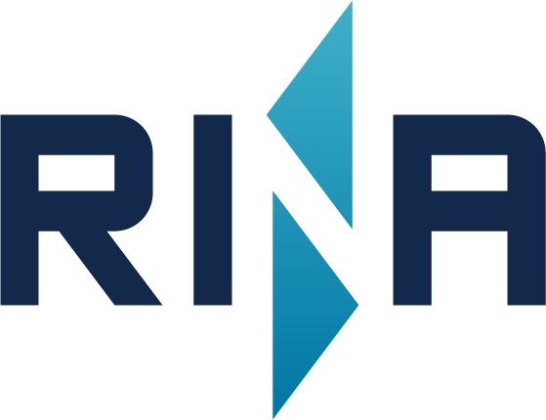
A Modelling Experience coupling modelling, process control and steel quality in continuous casting: SUNSHINE
Orlando Di Pietro (RINA-CSM)
Disclaimer: Views and opinions expressed are however those of the author(s) only and do not necessarily reflect those of EU/REA, which cannot can be held responsible for them.

Slide 3

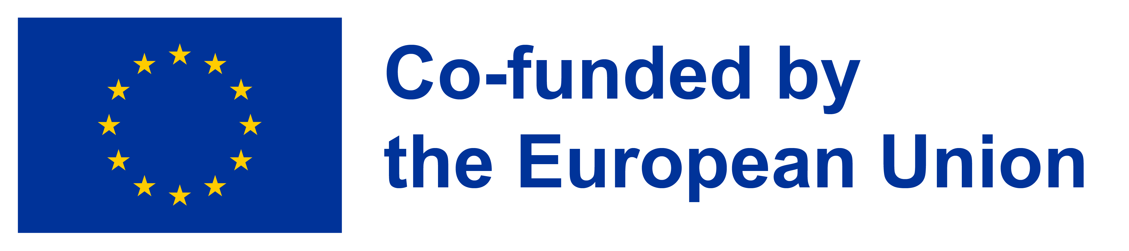
SUNSHINE
SUstainable New casting and rolling process monitoring/sensoring approach aimed at proper surface quality and SHape IN flat and long products, enabling Energy savings and smart management in the casting/rolling operations
Coordinator: Orlando Di Pietro – RINA-CSM
Call:​ RFCS-2017
Start date:​ 01/10/2024
End date:​ 31/03/2028
Total costs: 3.702 863.60 €

Slide 4
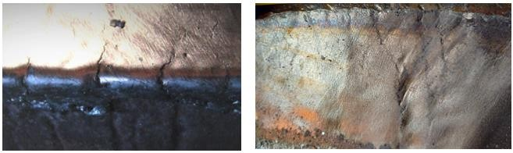
Context: State-of-art - 1
The primary causes of defects have been identified, and typical corrective measures have been outlined.
Geometric Defects: They appear as irregularities in the billet section shape (commonly referred to as ‘rhomboidity’) and can significantly hinder the loading and processing of billets.
Surface Defects: They include cracks and geometric irregularities (e.g., "off-corner" depressions, impacting on slabs quality). Addressing these issues is critical to keep production quality and efficiency.
Notes:
To ensure the accessibility of this presentation to blind users who use a screen reader,
if you translate this presentation or include parts not in English, make sure the proofing language is set to the right one (Review > Language > Set proofing Language). This will make sure the screen reader uses the right pronunciation.

Slide 5
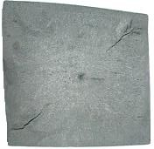
Context: State-of-art - 2
Rhomboidity refers to a shape defect in as-cast products, where the original square, rectangular, or round shape changes to a rhomboid, parallelogram, or oval. Severe cases may include internal cracks along the smaller diagonal or diameter. These defects cause difficulties in loading, pushing into the heating furnace, and entering the first rolling stand, leading to decreased productivity and increased costs.
Causes:
Mechanical/Maintenance Issues:
  Insufficient taper mould near the meniscus.
  Inadequate degrading towards the bottom to follow shell shrinkage.
  Asymmetric spray cooling.
Process Issues:
  Flow at meniscus prone to waves.
  Inadequate properties of powder.
Slab Surface Defects: Focus on surface cracks (transversal and corner cracks) which can affect any slab in the casting sequence, usually appearing as discontinuities on the broad and upper surface.
Notes:
To ensure the accessibility of this presentation to blind users who use a screen reader,
if you translate this presentation or include parts not in English, make sure the proofing language is set to the right one (Review > Language > Set proofing Language). This will make sure the screen reader uses the right pronunciation.

Slide 6
Context: State-of-art - 3
So, as step forward, an advanced investigation approach is needed by advanced techniques:
Numerical Modelling and Lab Support: Utilizing integrated numerical codes.
Dedicated Sensoring: Enabling real-time applicable models and AI tools.
This to drive from a 'knowledge' investigation to a 'know-how' approach, tailoring countermeasures for effective problem-solving on.
Geometric Defects and Crack Formation: at four industrial plants.
Integrated Approach: Combining casting and rolling processes in a decision support tool for managing the whole process.
¹⁾ Depending on the state of progress of the project, i.e. PR1 or PR2
Notes:
To ensure the accessibility of this presentation to blind users who use a screen reader,
if you translate this presentation or include parts not in English, make sure the proofing language is set to the right one (Review > Language > Set proofing Language). This will make sure the screen reader uses the right pronunciation.

Slide 7
Project overview
Scenario and Aims: Non-uniform in-mould solidification in long and flat products can cause defects (e.g., rhomboidity, bulging, cracks) affecting quality and production flow, especially with hot direct charging to reheating furnaces. This proposal aims to detect defects early and identify incorrect process conditions using in-line sensors and models.
Novelty of Approach: The SUNSHINE project integrates advanced shape and temperature monitoring technologies with comprehensive knowledge on defect causes, making them transferable to other casting plants, either for long and flat products.
The project combines databases, innovative simulations, and AI technologies into an integrated concept for industrial control, supporting the steel industry's transformation towards a green and digital future.
The SUNSHINE project features technologies at various TRLs, including wireless thermal mapping (TRL 4), fiber-optical temperature sensors (TRL 5), and AI/ML-driven process control (TRL 6) but the final overall concept refers to a final TRL = 7 (plant application)
Notes:
To ensure the accessibility of this presentation to blind users who use a screen reader,
if you translate this presentation or include parts not in English, make sure the proofing language is set to the right one (Review > Language > Set proofing Language). This will make sure the screen reader uses the right pronunciation.

Slide 8
Set up of Solidification and Microstructure Models
Objective:
Implement off-line CFD-simulation coupled models for as-cast product solidification by CSM.
Scope:
Include all operating conditions from mould to secondary cooling for Feralpi, Sidenor, and AdI casters.
Features:
Based on Ansys Fluent code
Implemented the Navier, Stokes, and conservation of energy equations
Solidification with Darcy's Law (solid fraction = (T-Tsolidus)/(Tliquidus-Tsolidus) ꞓ [0,1]
Output: maps of speed, temperatures, solid fraction
Input
Steel properties (density, viscosity, solidus and liquidus temperatures, thermo-physical properties – latent heat, conductivity...) Operating conditions (geometry, casting speed and temperature, heat exchange conditions – mould, secondary …).

Slide 9
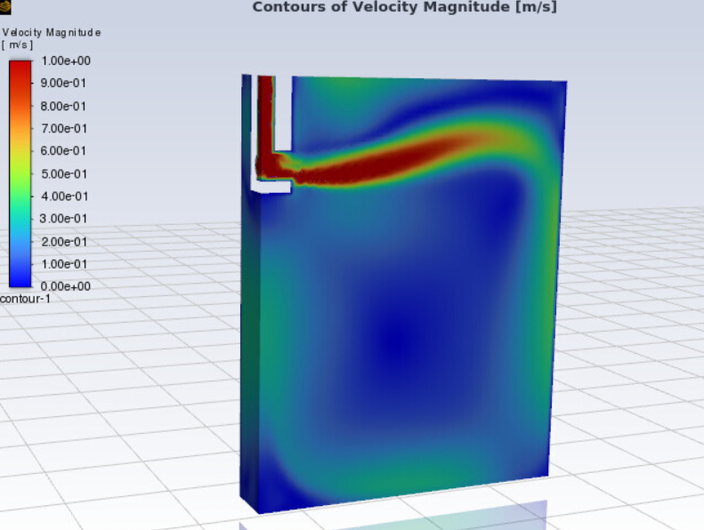
The CFD Model: Output
Typical Flow field in the mould (1/4 for symmetry)

Slide 10

Set up of a Thermomechanical Module for As-Cast Product Solidification
Objectives:
Establish a thermomechanical module for industrial casters of Sidenor, AdI, and Feralpi.
Optimize conditions for different mould shapes at Feralpi to increase casting speed and productivity.
Features
Address deformation, thermal stresses, and crack formation risks to ensure product quality and avoid scrapped products.
Adopt thermo-plasticity models from literature as constitutive law.
Estimate constitutive parameters experimentally for chosen steel grades within other tasks

Slide 11
Create Artificial Intelligence / Machine Learning tool
Objective: Develop machine learning models to predict potential product defects based on historical plant data
Approach:
  Supervised Models: Train models like SVM and XGBoost.
  Unsupervised Models: Apply to observations with defects and irregularities.
Process:
  Training: Divide dataset into training and testing subsets.
  Evaluation: Iteratively assess performance and optimize parameters.
  Selection: Choose the best model for deployment.
Validation:
  Apply robust validation techniques on historical data.
  Use error metrics such as accuracy in defect recognition and precision of forecast

Slide 12
Expected impact and KPIs - 1​
Align with EU Priorities
The proposal aims to improve continuous casting in steelmaking, aligning with the RFCS programme's objectives under Council Decision 2008/376/EC. It focuses on:
Optimizing steel processes through advanced technologies like digitalization, big data, and AI.
Enhancing maintenance and reliability of production tools.
Increasing energy efficiency and preventing energy losses.
Developing predictive simulation models for microstructures, mechanical properties, and production processes.
Aligned with Green Deal Solutions, the proposal seeks to reduce energy consumption, greenhouse gas emissions, and raw material usage by adopting a zero-defect strategy. It aims to:
Identify conditions causing shape and surface defects.
Improve internal and surface quality to reduce scrap and CO2 emissions.
Reduce standby time of casting strands for faster transfer to rolling
Innovative tools for process monitoring and control are proposed to enhance industrial efficiency, product quality, and production performance, for production modernization/digitalization.
Problem solving
Notes:
To ensure the accessibility of this presentation to blind users who use a screen reader,
if you translate this presentation or include parts not in English, make sure the proofing language is set to the right one (Review > Language > Set proofing Language). This will make sure the screen reader uses the right pronunciation.

Slide 13
Expected impact and KPIs - 2​
Socio-Economic Impact
Reduction of Defects
60% reduction in shape and surface defects in as-cast products
Productivity and Yield
1% increase in good material yield and productivity
CO2 Emissions Reduction
2000 kg/t decrease in CO2 emissions in integrated steel plants
600 kg/t decrease in CO2 emissions in electric steelmaking plants
Energy Savings and Material Loss Reduction
Improved connection between casting and rolling via direct hot billets charging
90% reduction in material flow issues due to shape defects
Decreased energy consumption and CO2 emissions through electrical induction heating instead of gas heating.
Notes:
To ensure the accessibility of this presentation to blind users who use a screen reader,
if you translate this presentation or include parts not in English, make sure the proofing language is set to the right one (Review > Language > Set proofing Language). This will make sure the screen reader uses the right pronunciation.

Slide 14
Next steps​
Knowledge Sharing:
Work Package 7 focuses on disseminating project results to the European steelmaking industry through various activities and channels. This includes contributions to technical conferences, journals, and expert groups. Key dissemination measures include:
Presentations at major conferences such as ECCC, ESTAD, SteelSIM, and AIM.
Publication of at least 2 papers in journals like Steel Research International and La Metallurgia Italiana.
At least 2 presentations/posters at official events.
A final workshop and a dedicated webinar for broader dissemination.
A project webpage for sharing results and updates, supported by social media.
The aim is to reach key players and context setters in the steel industry, including researchers, universities, and suppliers.
Notes:
To ensure the accessibility of this presentation to blind users who use a screen reader,
if you translate this presentation or include parts not in English, make sure the proofing language is set to the right one (Review > Language > Set proofing Language). This will make sure the screen reader uses the right pronunciation.

Slide 15
Towards industrial application​s
Industrial partner | Problem to face | Plant in focus | Methods: Models, sensors and integration
Sidenor | Geometry defects | Billet caster (end of casting) | Offline CFD simulation (solidification), IDS & Tempsimu with thermomechanical module (solidification and cooling); Cameras & laser (shape measurement); Data-driven analysis (correlations between casting conditions and geometry defects); At-line monitoring and countermeasures
Feralpi | Geometry defects | Billet caster (mould, end of casting) and rolling | Offline CFD simulation, thermomechanical models (solidification and cooling); billet shape measurement, new mould profile with thermal mapping via wireless thermocouples; Data-driven analysis (correlations between casting conditions and geometry defects; Connection between casting and rolling; Online casting simulation and control loop for casting parameters for high productivity via reduction of defects with maximum velocity of billet transfer to the rolling process.
AdI | Surface defects | Slab caster (end of casting) | Offline CFD simulation, IDS & Tempsimu with thermomechanical module (solidification and cooling), Online model (AI/ML), Virtual sensor (surface crack detection); Data-driven analysis (correlations between casting conditions and surface defects); Online monitoring and countermeasures
AGDH | Off-corner depressions | Slab caster (mould) | Digital twin based on CFD and FEM (solidification), transferred into online model (surrogate model); Two mould T measurements with FOTS (for steel flow & T inhomogeneities in moulds); Data-driven analysis (correlations between casting conditions and off-corner depressions); At-line monitoring and countermeasures
Demo cases and modeling involvement and support
Notes:
To ensure the accessibility of this presentation to blind users who use a screen reader,
if you translate this presentation or include parts not in English, make sure the proofing language is set to the right one (Review > Language > Set proofing Language). This will make sure the screen reader uses the right pronunciation.

Slide 16
Towards industrial application​s
Intellectual property strategy:
The IPR Strategy focuses on protecting and exploiting project results, supporting partners in a business-oriented approach.
It includes managing sensitive data in AI architecture and sensor development. The strategy aims to prevent property conflicts by clarifying ownership at each stage.
Three IPR levels are identified: Individual/Joint, Generic, and Public.
Key aspects include data ownership, algorithm transparency, and cybersecurity.
Each partner is responsible for their intellectual property, and a General Assembly will oversee top-level management and IPR issues.
Notes:
To ensure the accessibility of this presentation to blind users who use a screen reader,
if you translate this presentation or include parts not in English, make sure the proofing language is set to the right one (Review > Language > Set proofing Language). This will make sure the screen reader uses the right pronunciation.

Slide 17
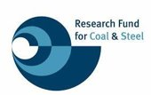
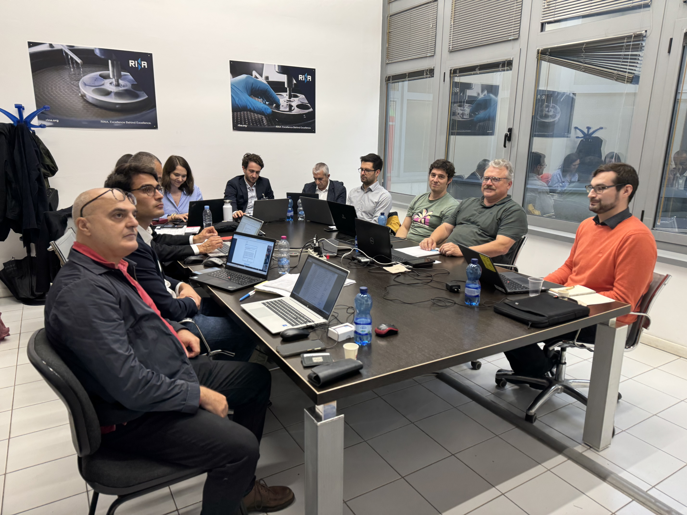
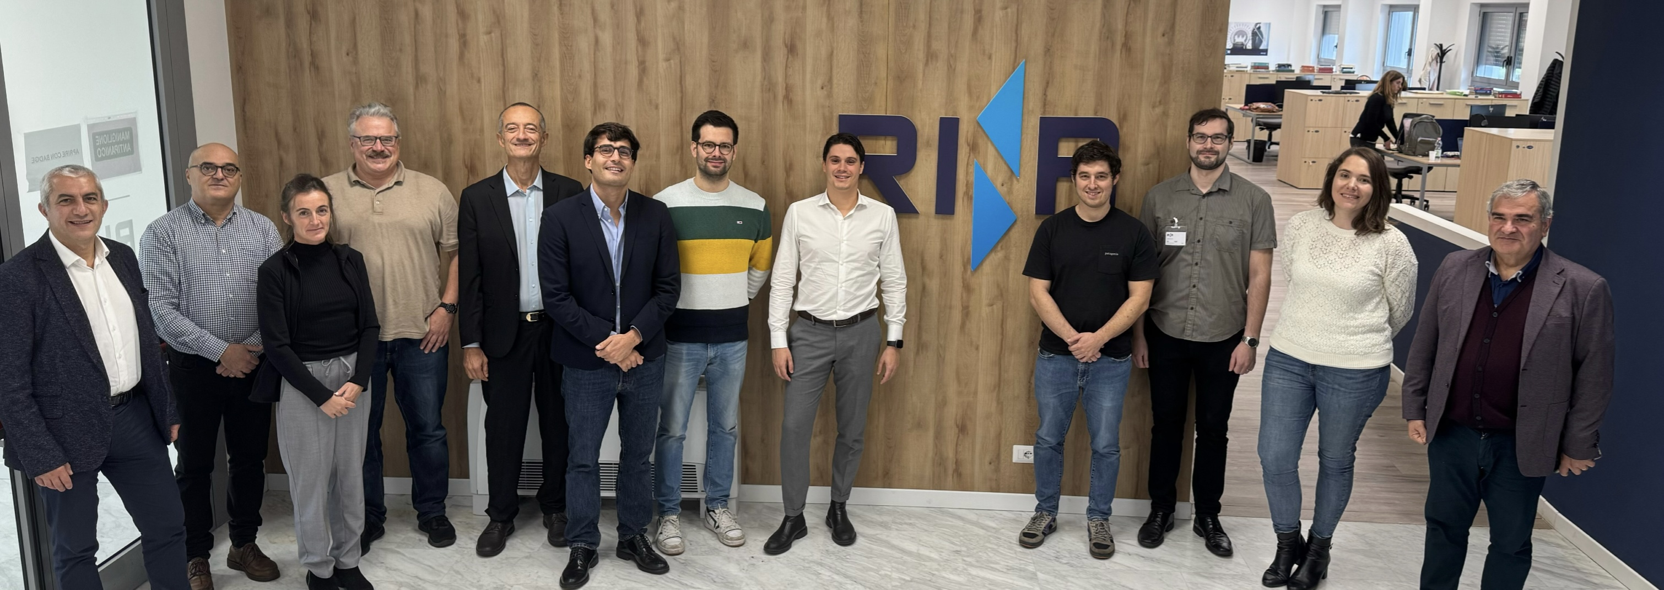
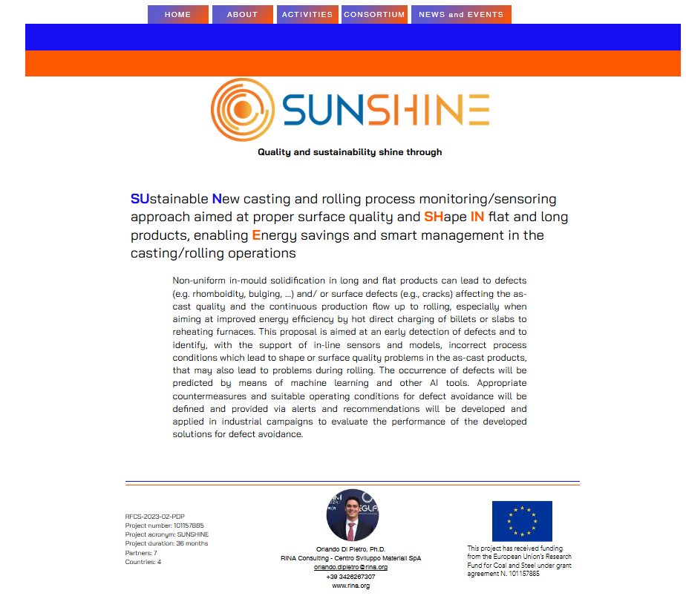
Thank you for your attention!
Orlando Di Pietro, RINA-CSM
https://project-sunshine.eu/
17

Slide 18
Issues behind the project
Non-uniform in-mould solidification in long and flat products can lead to shape defects (e.g., rhomboidity, off-corner depressions…) and/or surface defects (e.g., surface transversal and corner cracks) affecting as-cast quality and productivity.
Long products casting suffers improper heat transfer conditions for solidification in the mould and in the secondary cooling zone.
Main project Objectives
Early detection of unfavorable process conditions which lead to these defects.
Identification, with the support of sensors and models, of shape or quality problems in the cast product leading to drawbacks during rolling and/or in direct connection with reheating furnaces and billets welding problems.
Notes:
To ensure the accessibility of this presentation to blind users who use a screen reader,
if you translate this presentation or include parts not in English, make sure the proofing language is set to the right one (Review > Language > Set proofing Language). This will make sure the screen reader uses the right pronunciation.

Slide 19
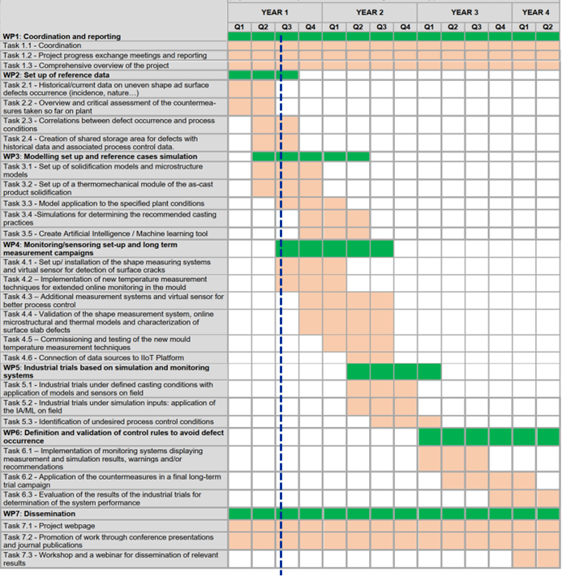
Project results
The project started on 01/10/2024, so the info concerning the comprehensive overview of the project are shown hereinafter (State of the art and approach/targets)
As current status, reference data collection was made as well as modelling set up and adaptation to the industrial scenarios
Notes:
To ensure the accessibility of this presentation to blind users who use a screen reader,
if you translate this presentation or include parts not in English, make sure the proofing language is set to the right one (Review > Language > Set proofing Language). This will make sure the screen reader uses the right pronunciation.

