Slide 1


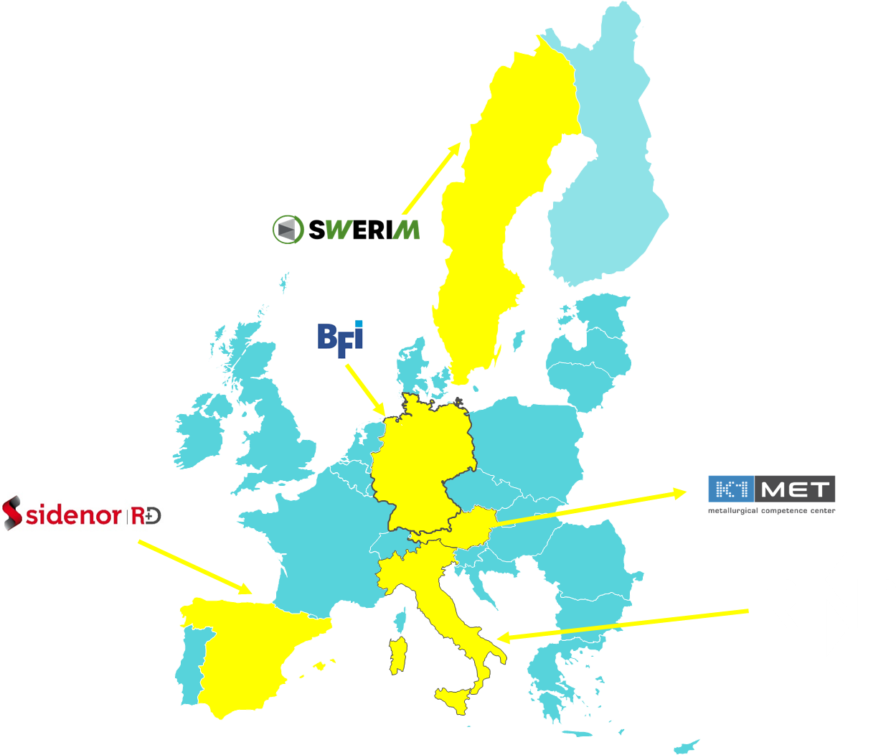
METACAST
Mapping, Educating, Training, Applying models in continuous CASTing
WEBINAR
Modelling Experience in Continuous Casting:
From Fundamentals to Problem Solving
Dec 4th – 14.30-16.30

Slide 2
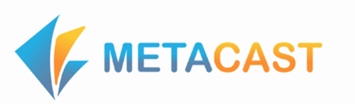
Agenda
1 | Welcome and Introduction - (Edoardo D’Amanzo– Rina Consulting- CSM SpA)
2 | METACAST: Dissemination of the modelling Approach – (Michele De Santis – Rina Consulting - CSM SpA)-
4 | Simulating billet casting and solidification: the role of EMS to prevent central segregation (Prof. Carlo Mapelli – Politecnico di Milano)
5 | Coupling thermo-mechanics and solid shell formation: fundamental steel properties and physical approach (Arianna Gotti – Transvalor)
6 | Steel intermixing: from reactors mixing fundamentals to on-line process tools) (Michele De Santis – Rina Consulting - CSM SpA)
7 | Open discussion with audience on the webinar topics (comments, insights, experiences, lessons learnt)
8 | Wrap-up/Conclusions

Slide 3
METACAST
Mapping, Educating, Training, Applying models in continuous CASTing
Modelling Experience in Continuous Casting:
From Fundamentals to Problem Solving
Welcome and Introduction
Edoardo D’Amanzo (RINA-CSM)
Michele De Santis (RINA-CSM)
Disclaimer: Views and opinions expressed are however those of the author(s) only and do not necessarily reflect those of EU/REA, which cannot can be held responsible for them.

Slide 4
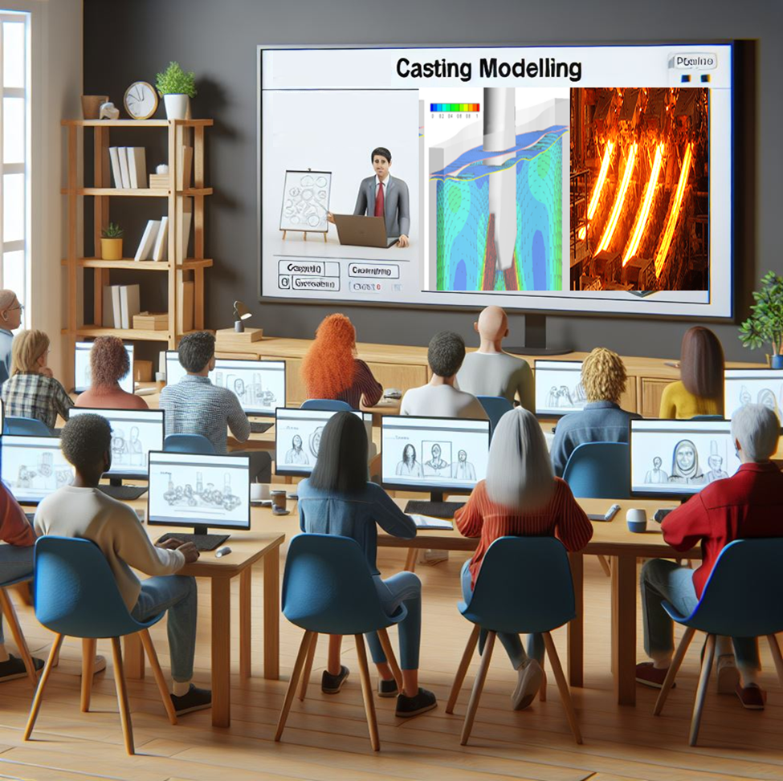
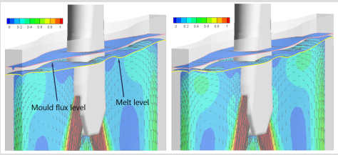
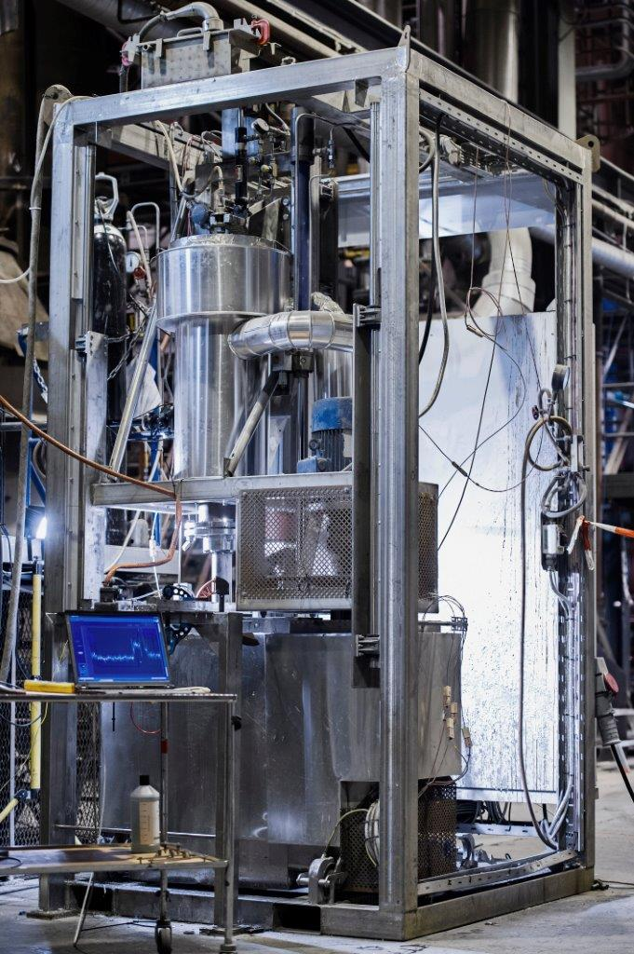
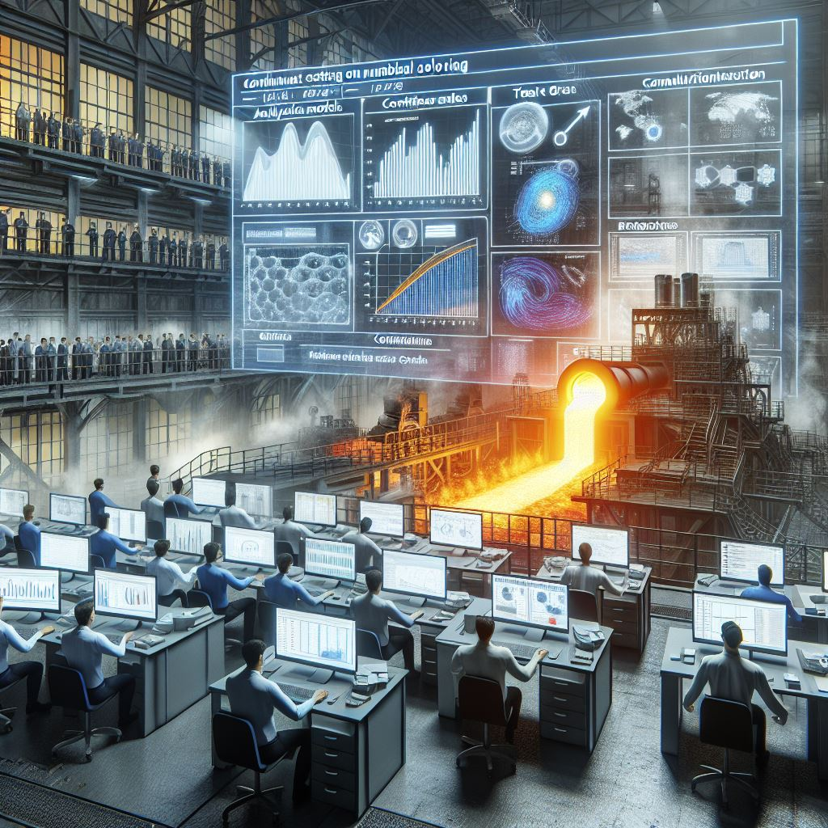
Project ‘METACAST’ : drivers
Continuous casting of steel involves complex physical phenomena—fluid flow, heat transfer, solidification, and segregation—that directly impact product quality and process efficiency.
Modelling is the key to understanding these mechanisms and turning theory into actionable solutions.
*https://www.privanova.com/resources/clustering-in-horizon-europe?/clustering-in-horizon-europe#:~:text=Multiplying%20impact%20of%20a%20project,achievement%20of%20their%20key%20impacts

Slide 5
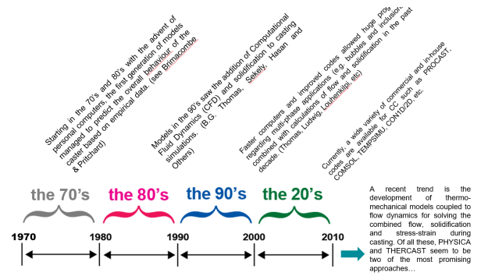
Modelling Importance
Starting point: the huge modelling potential achieved through RFCS projects to solve casting challenges in the European steel industry.
Recent advances on modelling disseminated in 3 areas:
Fundamental Research
Industrial Applications
Decision-Making
Trend so far:
improved models and time calculations,
Multiphasic approach,
Implementation for process control – AI tools

Slide 6
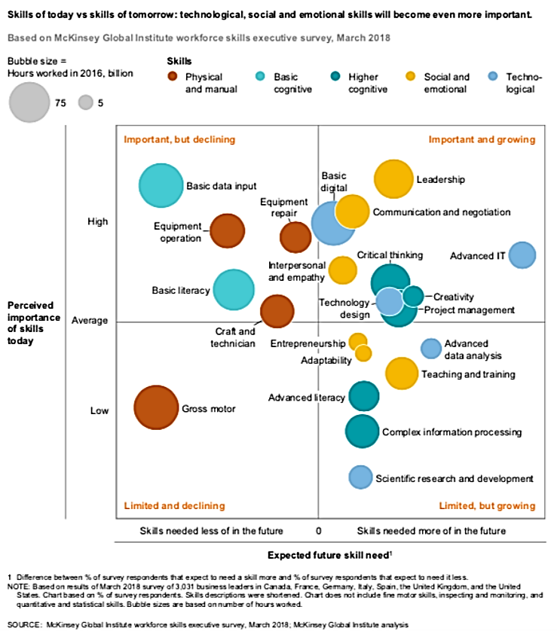
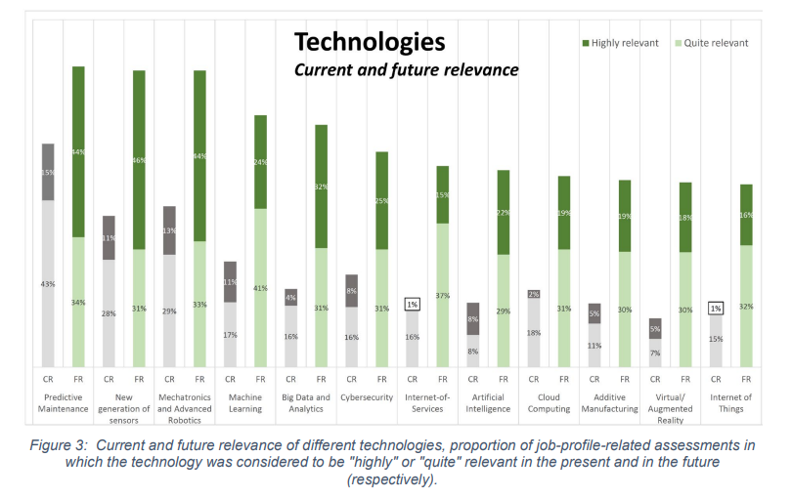
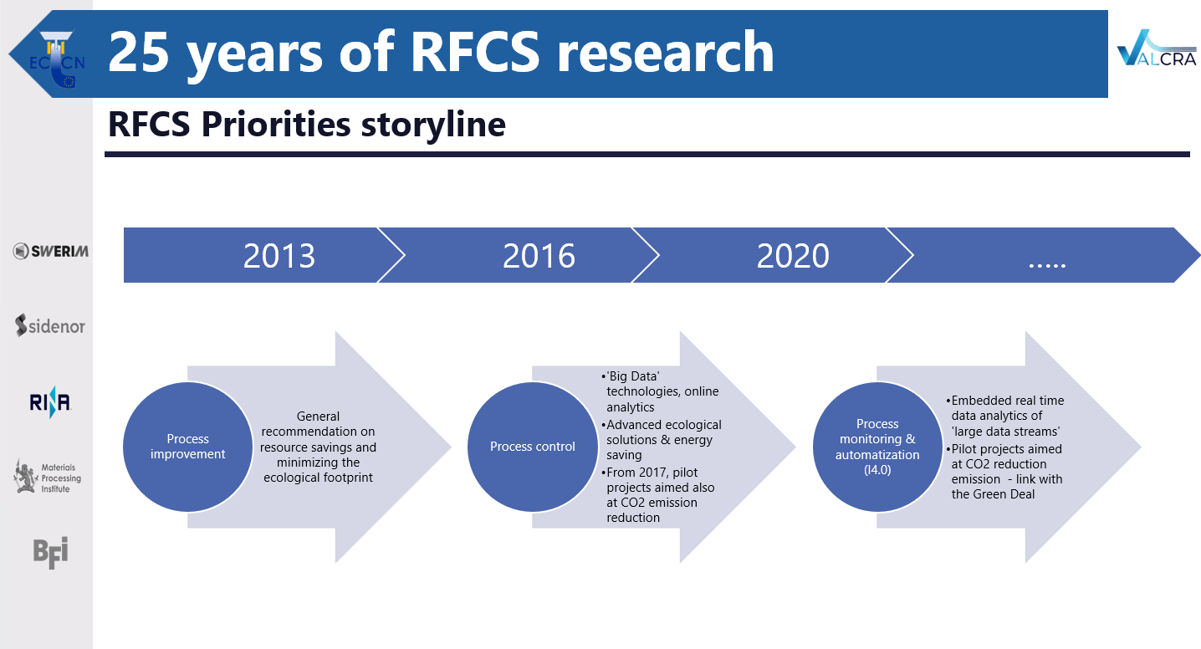
Trends and skills
… in line with the need of improved skill (also boosted by open training/dissemination events and targeting appropriate decision makers including researchers and managers) …
… as modelling is a pillar for problem solving and implementation in tools (see also the far-sighted storyline of RFCS priorities*)
* VALCRA RFCS-GA No. 84719
From Blueprint “New Skills Agenda Steel”: Industry-driven sustainable European Steel Skills Agenda and Strategy (ESSA)

Slide 7
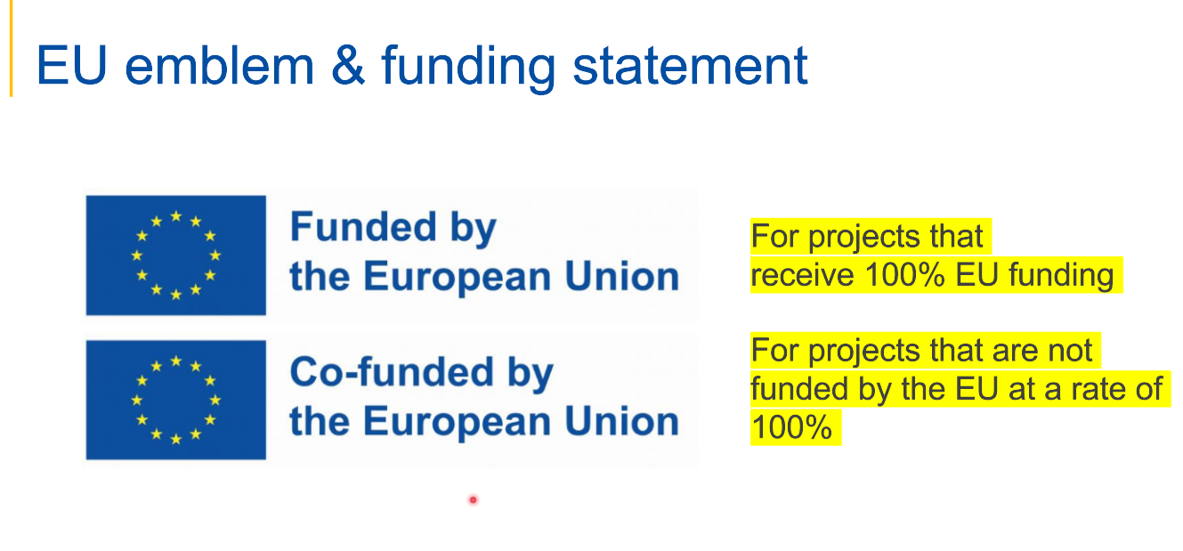
Problems tackled by METACAST
Facing problems solving in continuous casting production (quality, productivity,…) with reliable modelling, able to increase knowledge and know how and to enhance process control and AI tools (digital twins)
‘Reliable’ means correctly representing the phenomena involved, linked with quality issues and validated
Issue relevant for all stakeholders: either for producers, directly undergoing to the production drawbacks, and to technology providers, called to proved for products well integrated with advanced systems (the underutilization of advanced models and AI tools further hinders innovation and optimization)
Main objective(s)
Disseminating and promoting via events/documentation (KPI in D1.2) the use of modelling in continuous casting gained from fundamental research, for direct and immediate industrial application.
Improving the workers' conditions: from workplace safety/environmental issues to improved skill, by promoting training on advanced tools based on models (e.g., digital twins - interviews to stakeholders’ management.)

Slide 8
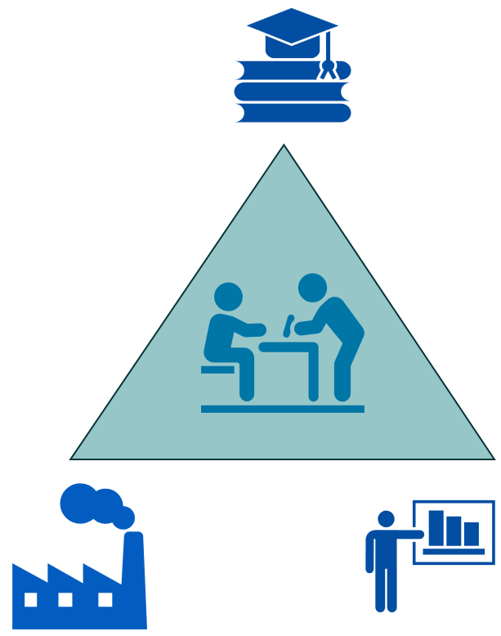
Skill & ‘Educational’ support
Interviews involving a ‘wide’ scenario :
R&D Directors
model developers / software-code producers
managers RTO - Machine Learning &AI
Academia in contact with stakeholders
Training events
Notes:
Application at industrial level (problem solving): with great impulse of R&D model-oriented approaches able to ensure practical benefits to companies (enhanced product quality and productivity in a systematic and sustainable scenario)
Exploitation of new market opportunities: a deeper knowledge of the processes being modelled can help to overcome issues related to new product and/or the needs of rearranging the current production to sustainable paradigms. To confirm this aspect, it is sufficient to have a look at this approach and step forward in the last decade for the companies/centres more skilled and occupying a strong position on the market, also distributed over several European countries.
Climate change/environmental changes challenges: a more sound knowledge of the phenomena faced by modelling - in most cases nowadays treated with a multi-physics approach and therefore implying more challenging implementation and higher computational cost - can help to point towards the industrial targets and at the same time taking into account the environmental sustainability, critical for the production in the next decades, as indicated in the ’Green Deal’ and the subsequent indications for steel producers up to 2050. In particular, all the objectives in the relevant document (including those referring to carbon neutral production via the typical pathways, Carbon Direct Avoidance, Smart Carbon Usage, Process Integration, Circular economy) should rely on R&D support also via modelling, to enable the current technologies to reach a deployment level reliable for industrialisation (i.e., enhancing the Technology Readiness Level from 7 to 9). So modelling is a key to strengthen the global competitiveness of the EU steel industry in line with the EU industrial strategy for steel (namely, Objective 6).
Benefits for the society: achieving higher levels of education with proper dissemination and leverage actions has, no doubt, a strong and positive impact on the awareness of driving the new technology towards new industrial challenges, but within the needed constraints of sustainability. The higher the public involvement in this action, the smoother the transition towards an industrial paradigm respectful of the environment and with the social consciousness and approval.
Ultimately, METACAST intends to provide guidance to managers and personnel in the steel industry on how to apply modelling results for improving the quality (both bulk and surface) of cast products. The application of modelling at an industrial level can have a major impact on steelmakers by reducing the amount of rejected material due to a better combination of casting conditions. Moreover, if the modelling is applied on-line, the benefit and impact can be considered of great importance towards Smart Manufacturing which is crucial to increase the resilience of the European Steel industry.

Slide 9

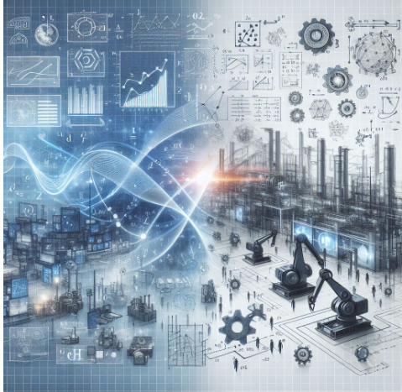

Expected webinar outcome
To explore how fundamental principles evolve into problem solving and practical tools that solve real-world challenges in steelmaking.
From academic research to industrial implementation, a journey from physics-based insights to plant-level applications.

Slide 10
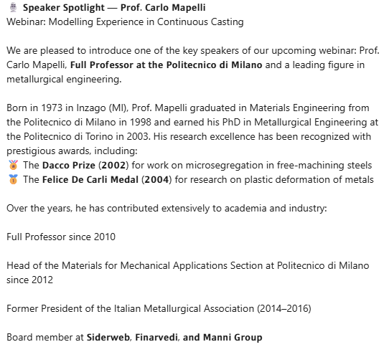
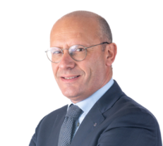
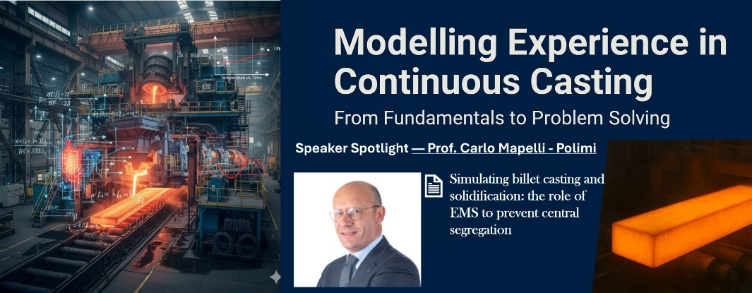
Speakers - 1
𝗧𝗼𝗽𝗶𝗰:
👉 𝘚𝘪𝘮𝘶𝘭𝘢𝘵𝘪𝘯𝘨 𝘣𝘪𝘭𝘭𝘦𝘵 𝘤𝘢𝘴𝘵𝘪𝘯𝘨 𝘢𝘯𝘥 𝘴𝘰𝘭𝘪𝘥𝘪𝘧𝘪𝘤𝘢𝘵𝘪𝘰𝘯: 𝘵𝘩𝘦 𝘳𝘰𝘭𝘦 𝘰𝘧 𝘌𝘔𝘚 𝘵𝘰 𝘱𝘳𝘦𝘷𝘦𝘯𝘵 𝘤𝘦𝘯𝘵𝘳𝘢𝘭 𝘴𝘦𝘨𝘳𝘦𝘨𝘢𝘵𝘪𝘰𝘯

Slide 11
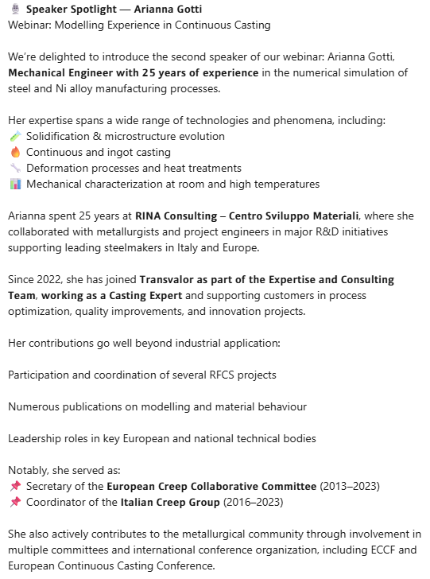
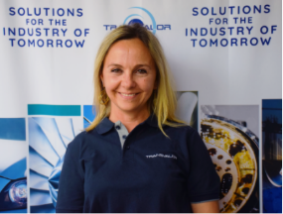
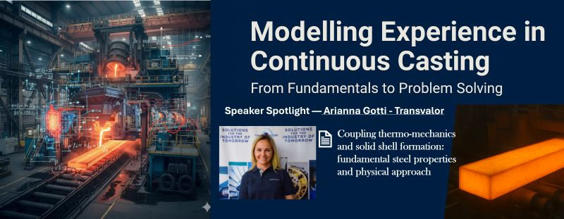
Speakers - 2
𝗧𝗼𝗽𝗶𝗰:
👉 𝘊𝘰𝘶𝘱𝘭𝘪𝘯𝘨 𝘵𝘩𝘦𝘳𝘮𝘰-𝘮𝘦𝘤𝘩𝘢𝘯𝘪𝘤𝘴 𝘢𝘯𝘥 𝘴𝘰𝘭𝘪𝘥 𝘴𝘩𝘦𝘭𝘭 𝘧𝘰𝘳𝘮𝘢𝘵𝘪𝘰𝘯: 𝘧𝘶𝘯𝘥𝘢𝘮𝘦𝘯𝘵𝘢𝘭 𝘴𝘵𝘦𝘦𝘭 𝘱𝘳𝘰𝘱𝘦𝘳𝘵𝘪𝘦𝘴 𝘢𝘯𝘥 𝘱𝘩𝘺𝘴𝘪𝘤𝘢𝘭 𝘢𝘱𝘱𝘳𝘰𝘢𝘤𝘩

Slide 12
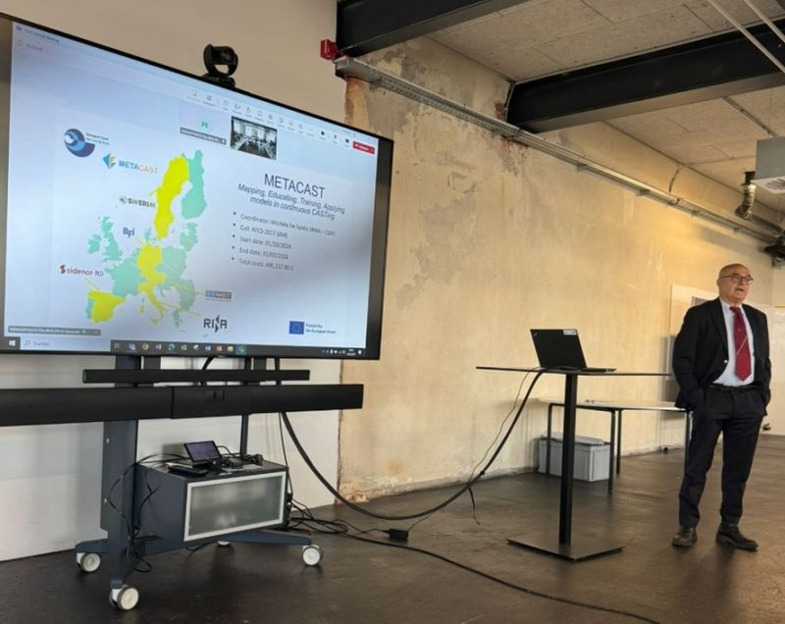
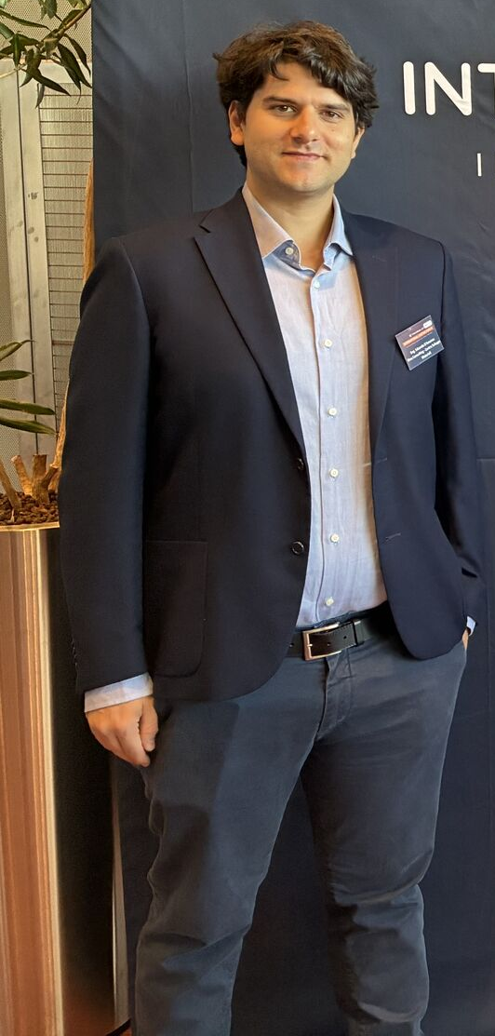
Speakers - 3
Edoardo D’Amanzo
RINA Consulting- CSM SpA
Webinar Q/A - Chairman
Michele De Santis
RINA Consulting - CSM SpA
METACAST Project Coordinator
𝗧𝗼𝗽𝗶𝗰:
👉 Steel intermixing: from reactors mixing fundamentals to on-line process tools)

Slide 13
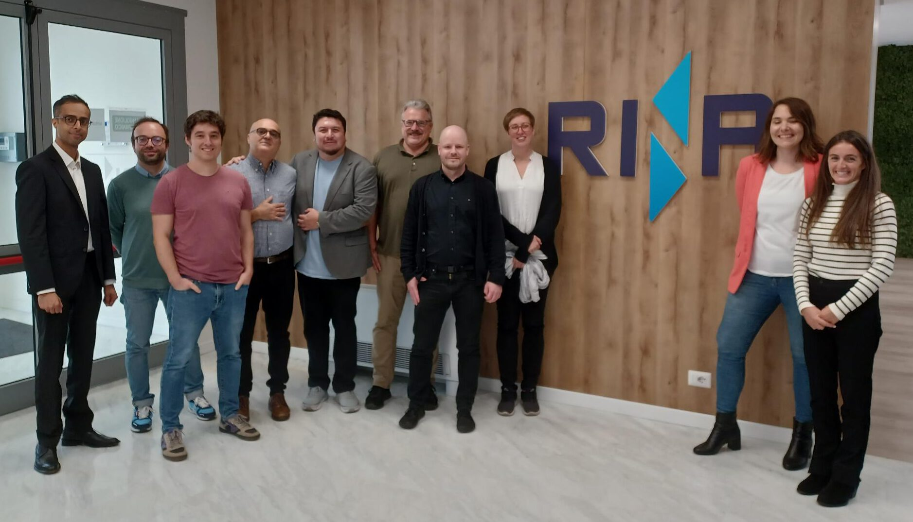
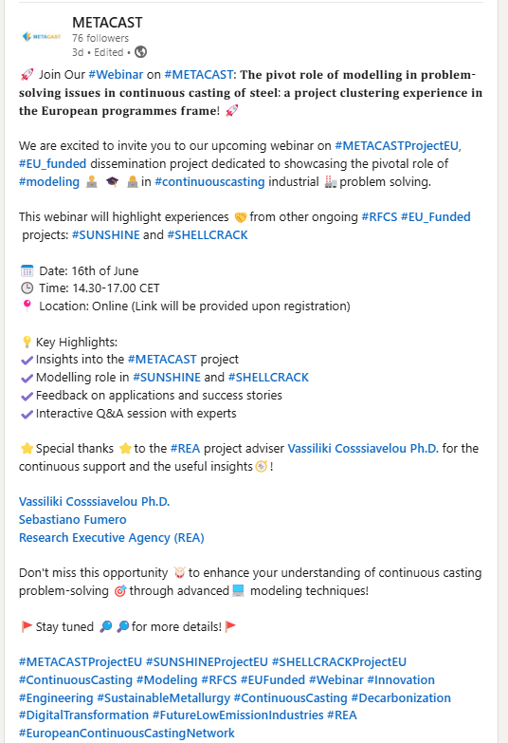
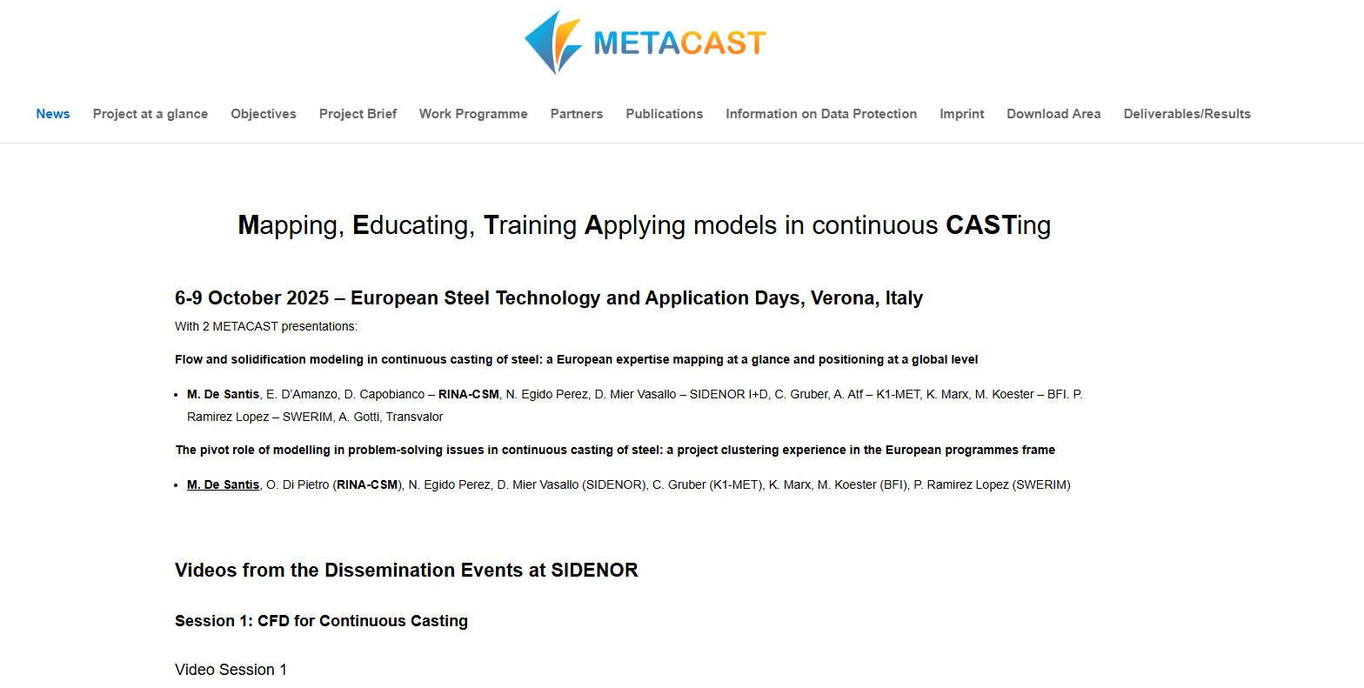
Have a fruitful webinar …
And see you at the Q/A panel for a fruitful discussion!
https://metacast-project.eu/
https://www.linkedin.com/company/105728781/admin/notifications/all/

