Slide 1


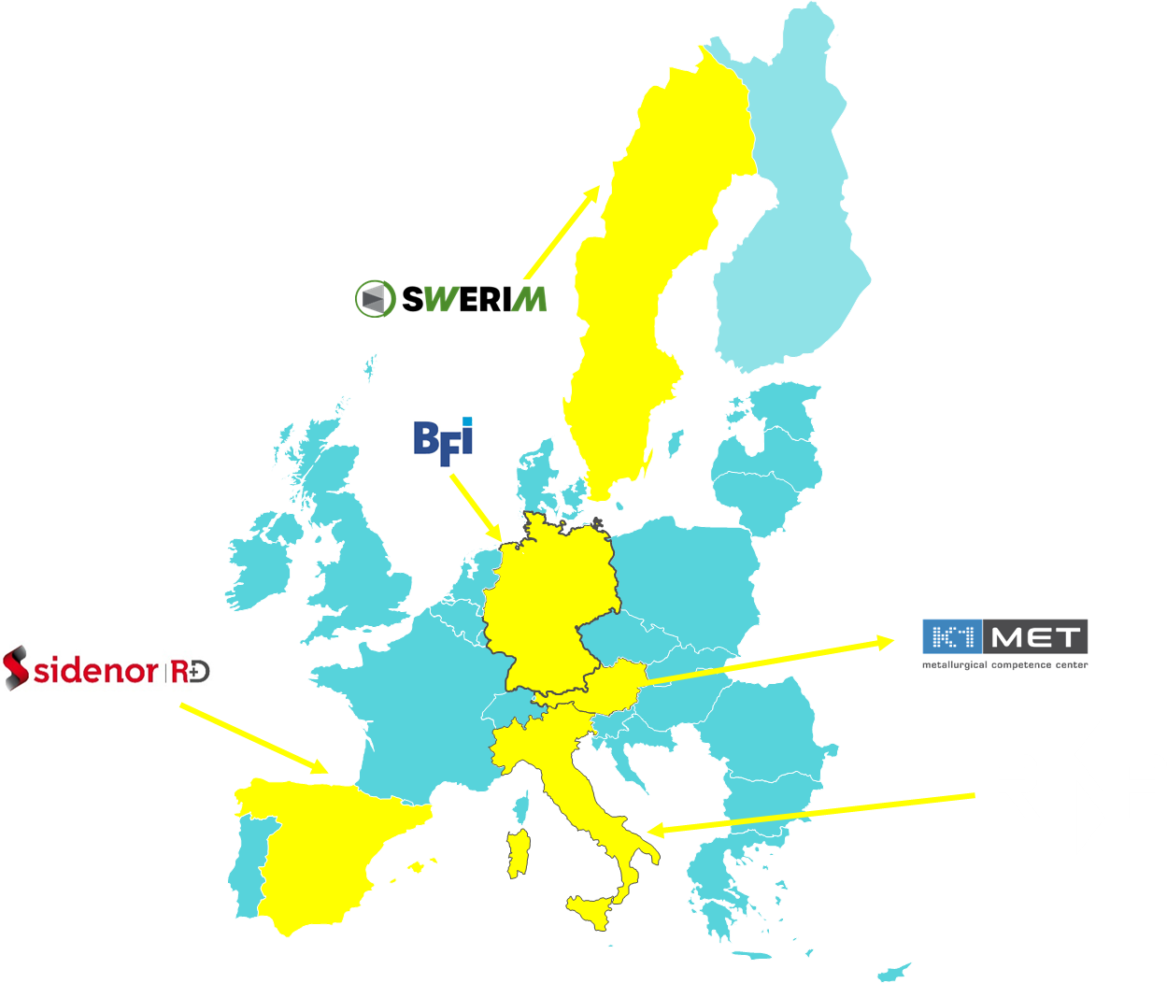
METACAST Mapping, Educating, Training, Applying models in continuous CASTing
WEBINAR
The pivot role of modelling in problem-solving issues in continuous casting of steel:
a project clustering experience in the European programmes frame
Michele De Santis (RINA-CSM)

Slide 2
METACAST Mapping, Educating, Training, Applying models in continuous CASTing
Open discussion with audience on modelling role in continuous casting problem solving & current efforts by stakeholders (experiences, lessons learnt, success stories)
Disclaimer: Views and opinions expressed are however those of the author(s) only and do not necessarily reflect those of EU/REA, which cannot can be held responsible for them.

Slide 3
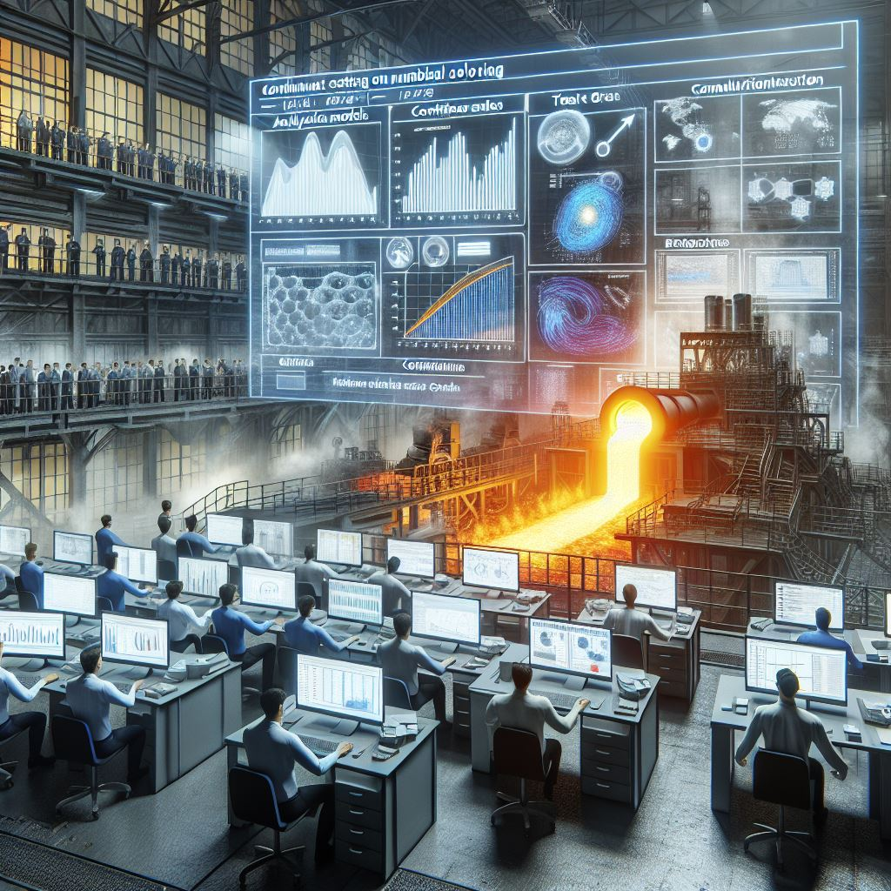

Wrap - up
Interesting and useful hints!
Asking for ‘volunteers’ for interviews/exchanging ideas on the topics discussed (make also use of our social media accounts, e.g. posts on LinkedIN to boost discussions)!
Notes:
Application at industrial level (problem solving): with great impulse of R&D model-oriented approaches able to ensure practical benefits to companies (enhanced product quality and productivity in a systematic and sustainable scenario)
Exploitation of new market opportunities: a deeper knowledge of the processes being modelled can help to overcome issues related to new product and/or the needs of rearranging the current production to sustainable paradigms. To confirm this aspect, it is sufficient to have a look at this approach and step forward in the last decade for the companies/centres more skilled and occupying a strong position on the market, also distributed over several European countries.
Climate change/environmental changes challenges: a more sound knowledge of the phenomena faced by modelling - in most cases nowadays treated with a multi-physics approach and therefore implying more challenging implementation and higher computational cost - can help to point towards the industrial targets and at the same time taking into account the environmental sustainability, critical for the production in the next decades, as indicated in the ’Green Deal’ and the subsequent indications for steel producers up to 2050. In particular, all the objectives in the relevant document (including those referring to carbon neutral production via the typical pathways, Carbon Direct Avoidance, Smart Carbon Usage, Process Integration, Circular economy) should rely on R&D support also via modelling, to enable the current technologies to reach a deployment level reliable for industrialisation (i.e., enhancing the Technology Readiness Level from 7 to 9). So modelling is a key to strengthen the global competitiveness of the EU steel industry in line with the EU industrial strategy for steel (namely, Objective 6).
Benefits for the society: achieving higher levels of education with proper dissemination and leverage actions has, no doubt, a strong and positive impact on the awareness of driving the new technology towards new industrial challenges, but within the needed constraints of sustainability. The higher the public involvement in this action, the smoother the transition towards an industrial paradigm respectful of the environment and with the social consciousness and approval.
Ultimately, METACAST intends to provide guidance to managers and personnel in the steel industry on how to apply modelling results for improving the quality (both bulk and surface) of cast products. The application of modelling at an industrial level can have a major impact on steelmakers by reducing the amount of rejected material due to a better combination of casting conditions. Moreover, if the modelling is applied on-line, the benefit and impact can be considered of great importance towards Smart Manufacturing which is crucial to increase the resilience of the European Steel industry.

Slide 4

Modelling & Clustering
If you want to go fast, go alone.
If you want to go far, go together
Notes:
Application at industrial level (problem solving): with great impulse of R&D model-oriented approaches able to ensure practical benefits to companies (enhanced product quality and productivity in a systematic and sustainable scenario)
Exploitation of new market opportunities: a deeper knowledge of the processes being modelled can help to overcome issues related to new product and/or the needs of rearranging the current production to sustainable paradigms. To confirm this aspect, it is sufficient to have a look at this approach and step forward in the last decade for the companies/centres more skilled and occupying a strong position on the market, also distributed over several European countries.
Climate change/environmental changes challenges: a more sound knowledge of the phenomena faced by modelling - in most cases nowadays treated with a multi-physics approach and therefore implying more challenging implementation and higher computational cost - can help to point towards the industrial targets and at the same time taking into account the environmental sustainability, critical for the production in the next decades, as indicated in the ’Green Deal’ and the subsequent indications for steel producers up to 2050. In particular, all the objectives in the relevant document (including those referring to carbon neutral production via the typical pathways, Carbon Direct Avoidance, Smart Carbon Usage, Process Integration, Circular economy) should rely on R&D support also via modelling, to enable the current technologies to reach a deployment level reliable for industrialisation (i.e., enhancing the Technology Readiness Level from 7 to 9). So modelling is a key to strengthen the global competitiveness of the EU steel industry in line with the EU industrial strategy for steel (namely, Objective 6).
Benefits for the society: achieving higher levels of education with proper dissemination and leverage actions has, no doubt, a strong and positive impact on the awareness of driving the new technology towards new industrial challenges, but within the needed constraints of sustainability. The higher the public involvement in this action, the smoother the transition towards an industrial paradigm respectful of the environment and with the social consciousness and approval.
Ultimately, METACAST intends to provide guidance to managers and personnel in the steel industry on how to apply modelling results for improving the quality (both bulk and surface) of cast products. The application of modelling at an industrial level can have a major impact on steelmakers by reducing the amount of rejected material due to a better combination of casting conditions. Moreover, if the modelling is applied on-line, the benefit and impact can be considered of great importance towards Smart Manufacturing which is crucial to increase the resilience of the European Steel industry.

Slide 5
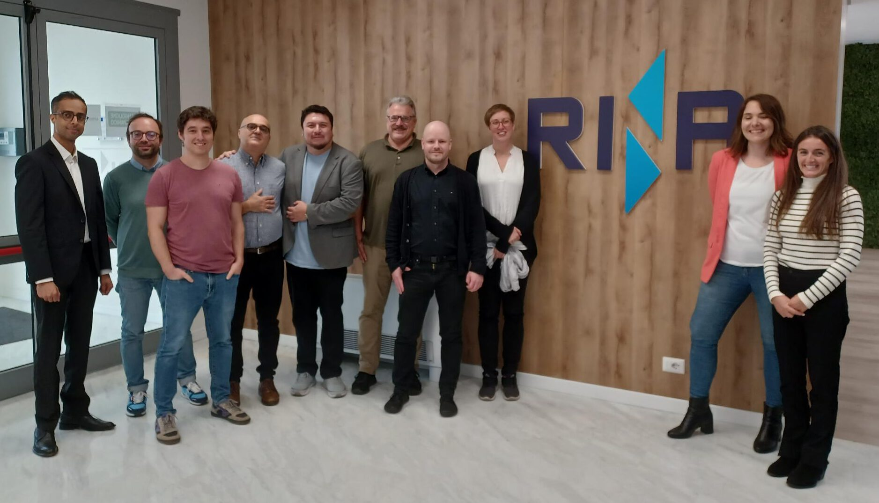
Thank you and…
https://metacast-project.eu/
https://www.linkedin.com/company/105728781/admin/dashboard/
… keep onboard for news!

Slide 6
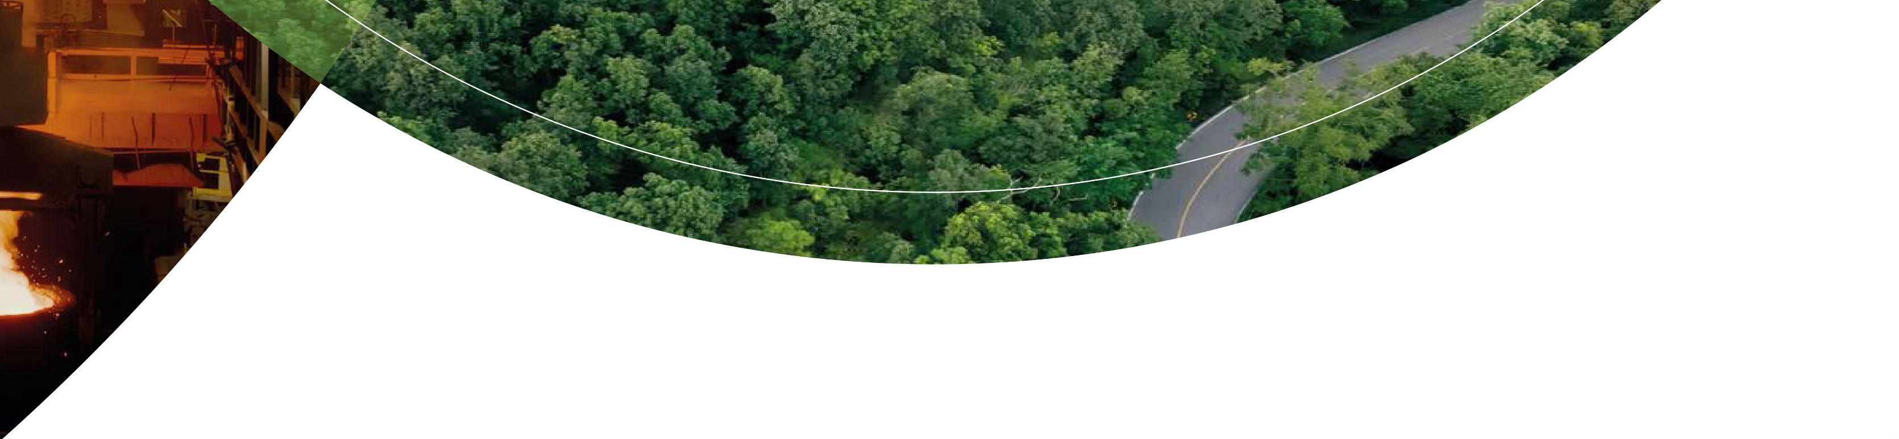
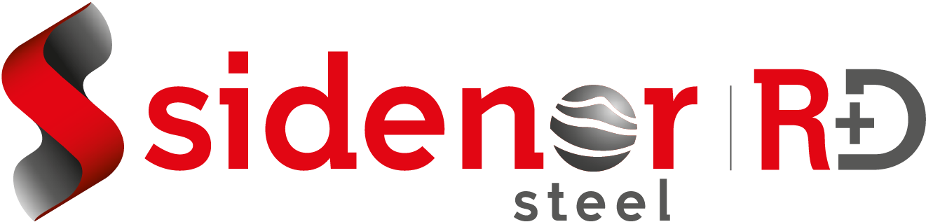
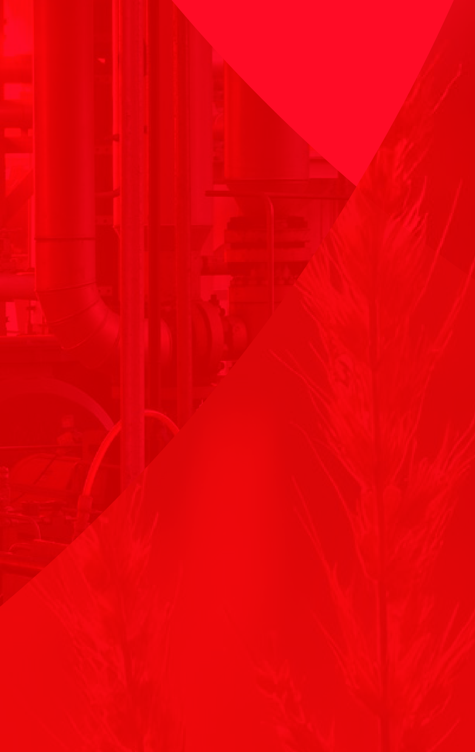




NEXT SEMINAR :SIDENOR & SWERIM
· Join Us ·
st
1 July 2025
Are you
interested?
Teams
(11:00 – 13:00)
Welcome
CFD for Coninuous Casting
Digital Twins
Experiences with modelling at Sidenor
Q&A sessin
End of seminar

