Slide 1








a
a
Steel intermixing: from reactors mixing fundamentals to on-line process tools
a
Michele De Santis (RINA Consulting- CSM SpA)
a

Slide 2
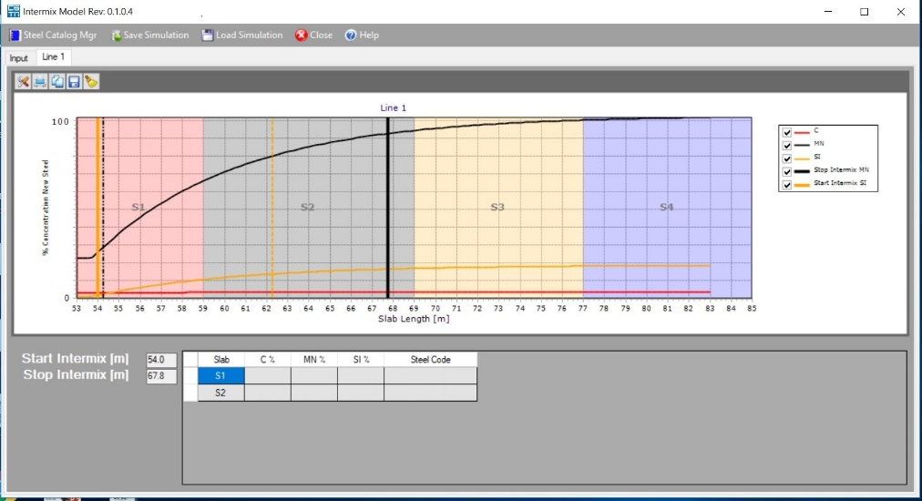
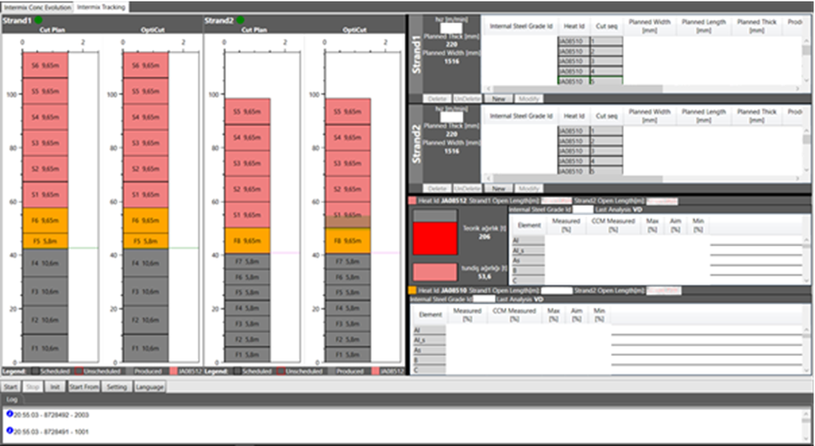
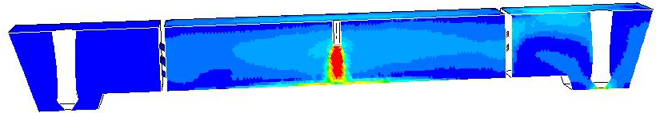
Problem-solving scenario
To monitor and manage steel intermixing in tundish, an online tool based on Computational Fluid Dynamics modelling* was developed, validated and applied (Colakoglu Metallurji 2-strands slab caster)
Different layout and operating conditions accounted for:
slab size,
presence of flow modifiers in tundish,
tundish refill time,
casting speed (also different from strand to strand),
steel grade.
*M. De Santis et al., Matériaux & Techniques. 107. 510. 10.1051/mattech/2020006.

Slide 3
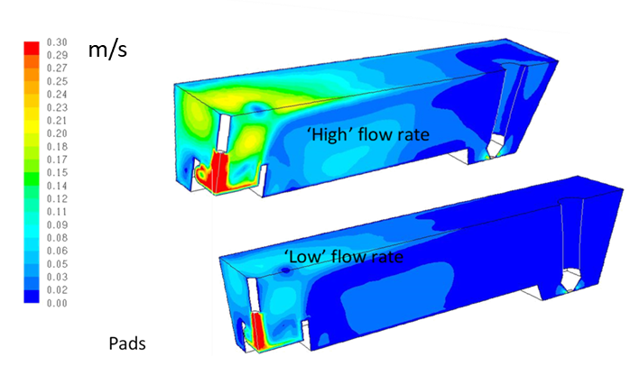
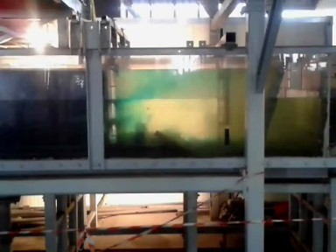
Aims of the study
The tool is based on a model describing element concentration variation at ladle change, with a general analytical form for the curves describing the grade change history in tundish
Curves achieved with cross-validation from CFD/water modelling.
Colakoglu Metallurji (CM) provided to a successful validation of such tool under different process conditions.

Slide 4
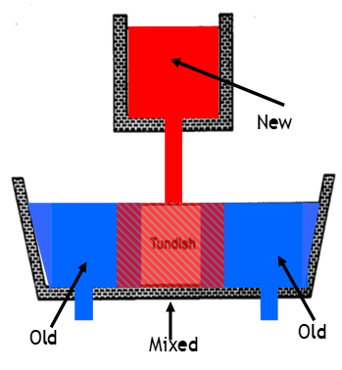
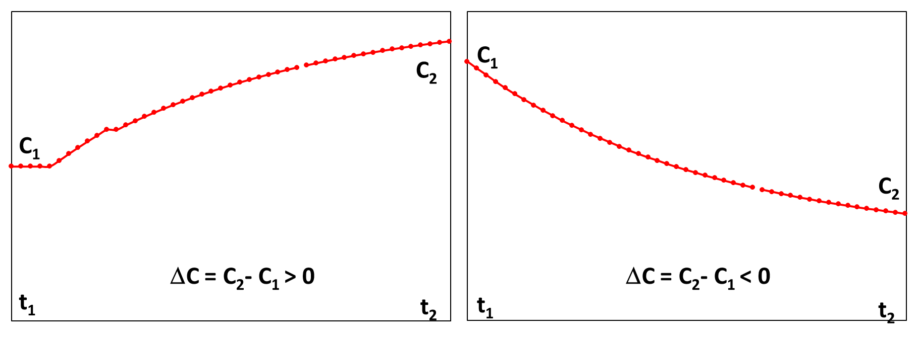
From industrial problem to technical issue
Element transition trend during intermixing. X axis: time. Y axis: Element concentration.
Left: element content decrease during grade transition, Right: element content decrease

Slide 5
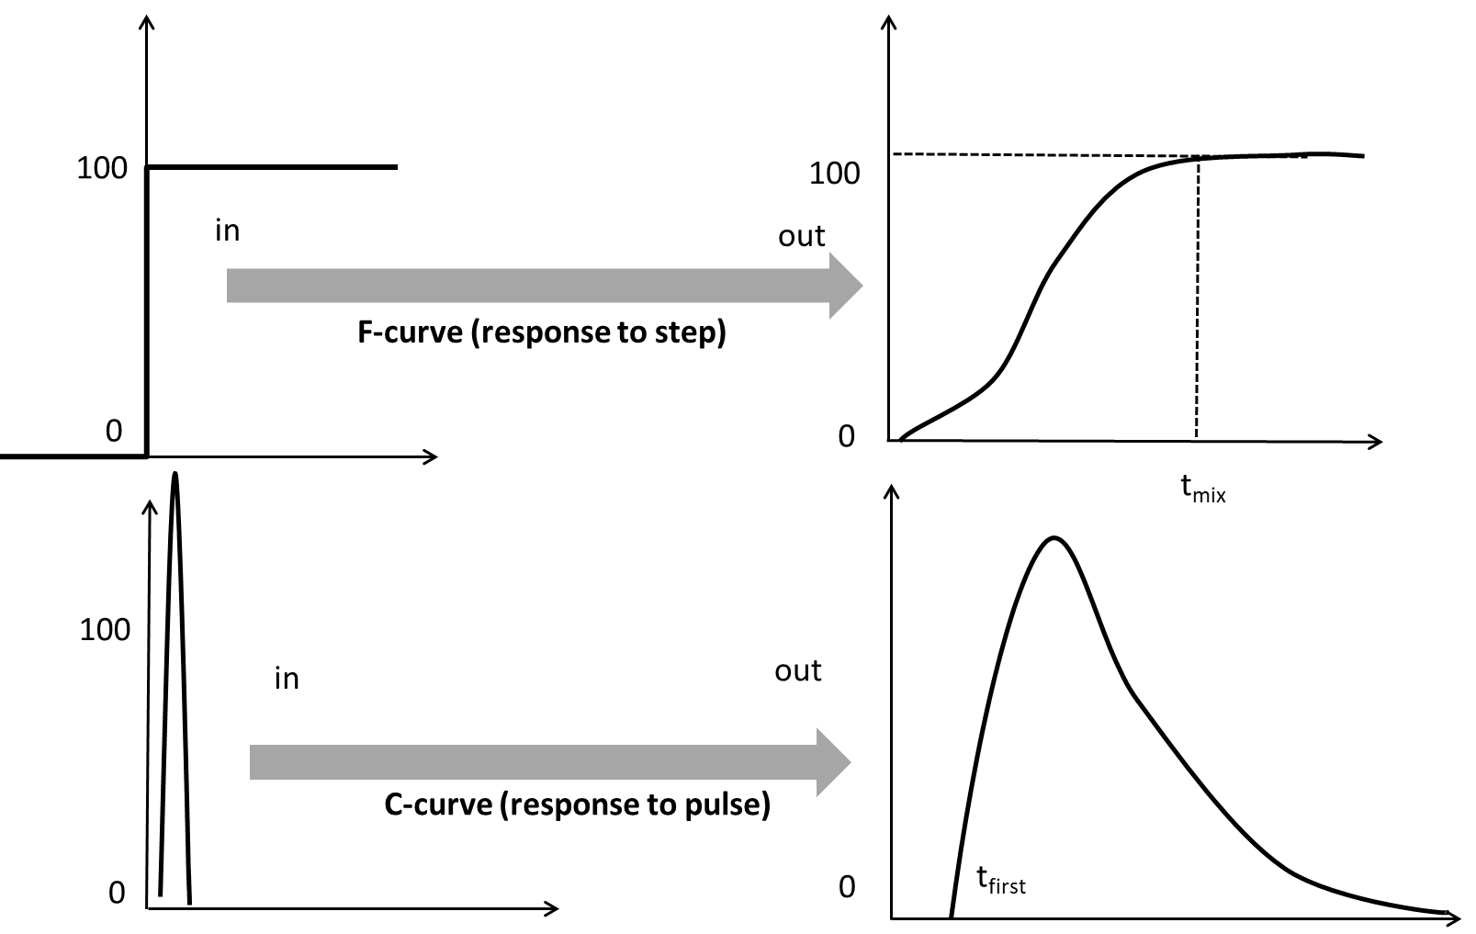
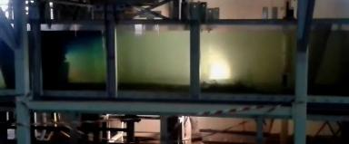
Fundamentals: tundish as a chemical reactor
Tracer visualisation technique to validate for C&F-curves

Slide 6
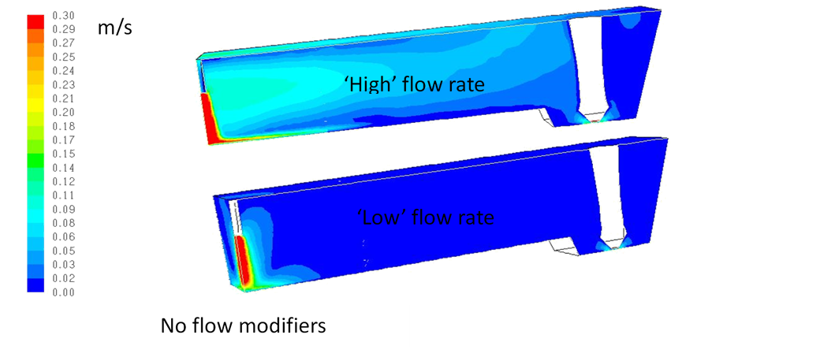
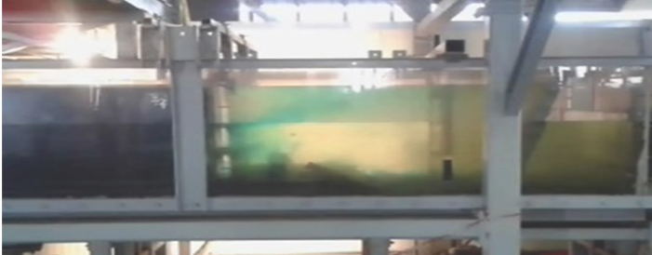
Modelling tools and approach - 1
Computational Fluid Modelling (CFD), via a validated Ansys-Fluent code already used for similar topics.
Meshing : body-fitted coordinates with about 1,000,000 hybrid cells.
Unsteady Reynolds Averaged-Navier-Stokes equations, standard wall functions treatment.
As solutor, a SIMPLE scheme, spatial discretisation with momentum-2nd order upwind. Turbulence described via the κ−ε model;
Physical modelling, via a flexible full scale tundish water model at CSM labs to reproduce the CC2 55-ton tundish of CM under steady-state operating conditions and at ladle change.

Slide 7
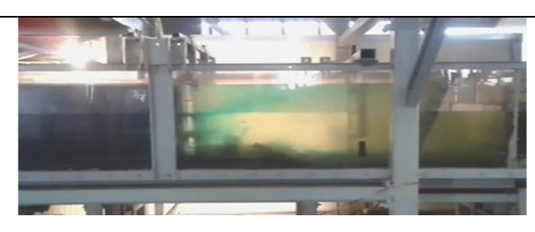
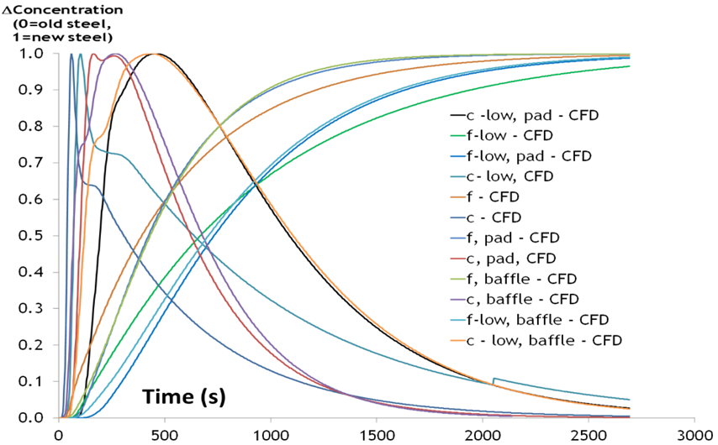
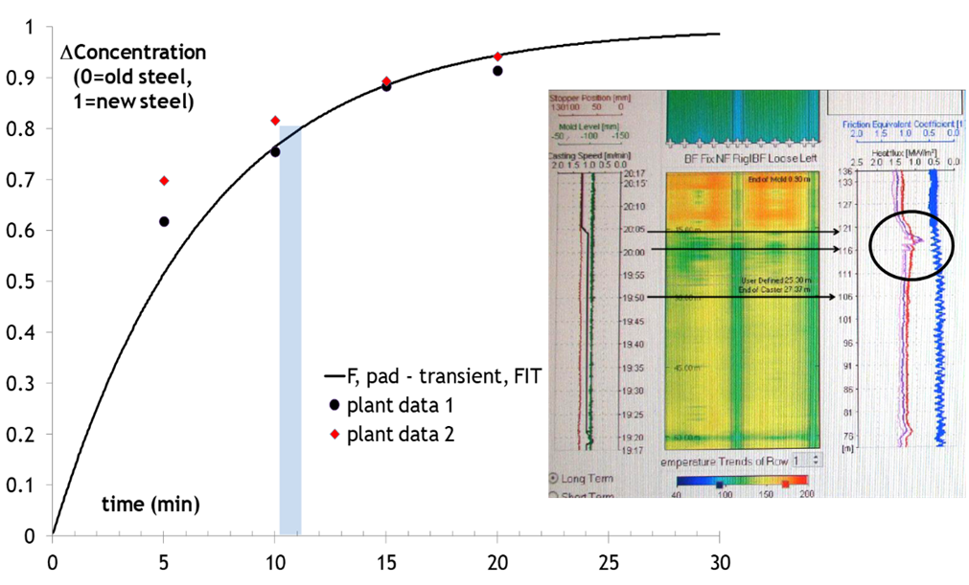
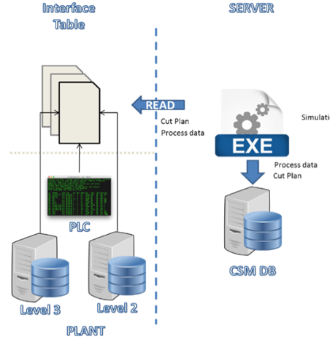
Modelling tools and approach - 2
Physical modelling = used to define the tundish mixing parameters.
CFD = to derive analytical mixing curves tuned with info from water modelling.
Then, a suitable and generalizable analytical algorithm developed to foresee the steel chemical composition of the steel after ladle change in function of the boundary conditions.
Tuning of the parameters model provided by plant data (slab sampling and verification of the intermixed length).
Finally, implementation in an offline & online tool

Slide 8
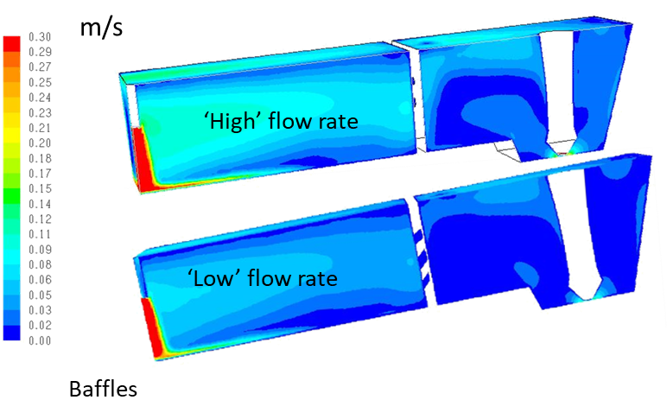
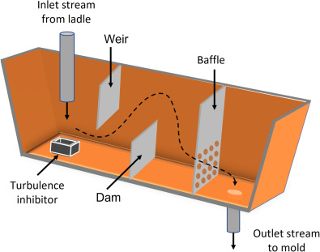
Example of results - 1
M. Kekkonen, Treatise on Process Metallurgy (II Edition), Vol. 3: Industrial Processes, 2024, 323-341

Slide 9
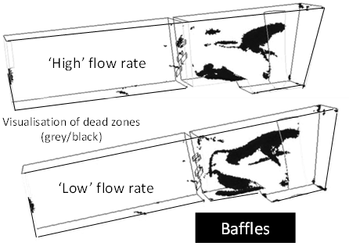
Example of results - 2
CFD - 1:1 water model cross validation of first appearance time and dead volumes
Tundish layout | water model | CFD modelling
no flow modifiers | 51 | 53
pad | 100 | 94
baffle | 86 | 81
Dimensionless results on dead volumes

Slide 10
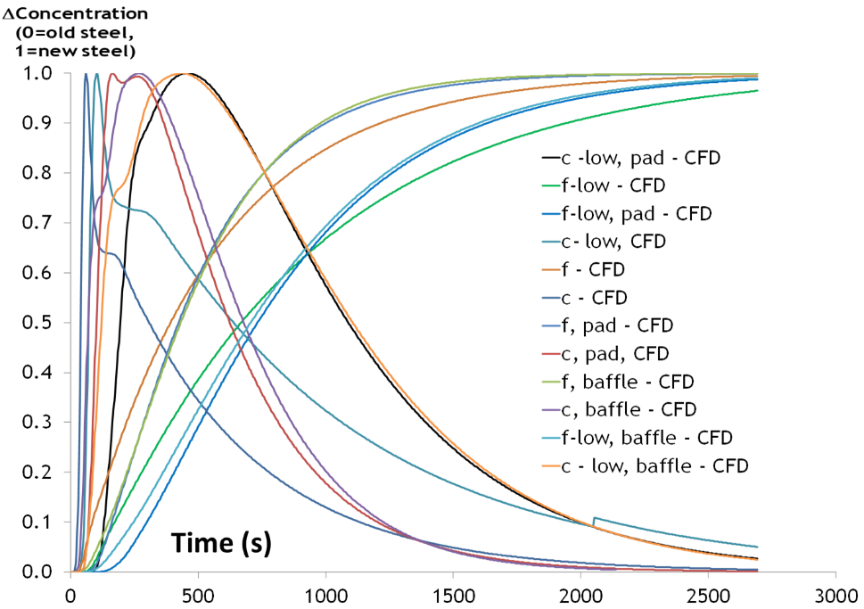
From simulation to formulation - 1
from C1 to C2, C2 > C1
from C1 to C2, C2 < C1.
Vs Strand length L
from C1 to C2, C2 > C1
from C1 to C2, C2 < C1.
Fitting curve parameters found for general curves from t_{P}, ṫ, α values (see next)
Notes:
The constant a can be related to perfect mixing volume, Its expression is (V-V_{dead}-V_{p})^{^0.5} . Fixed as 1 the reference values, for pads and baffles this value is respectively 20% and 15% higher

Slide 11
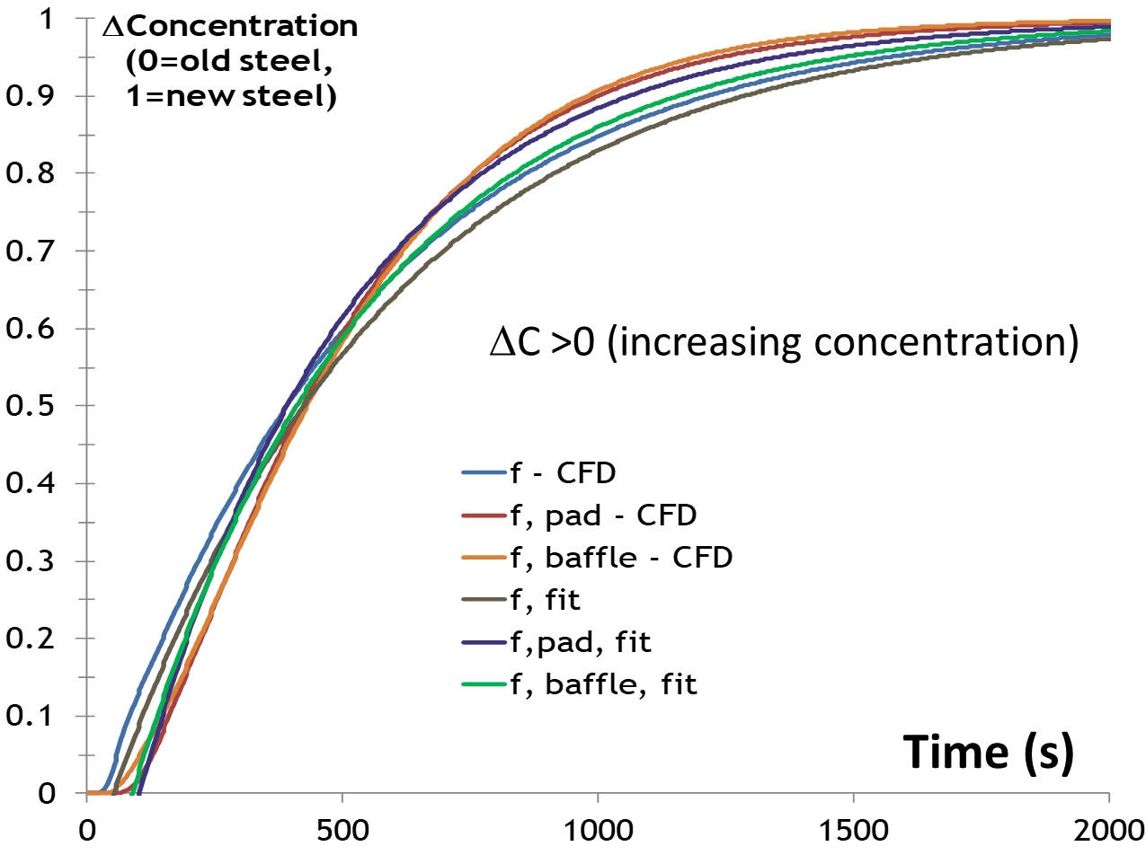
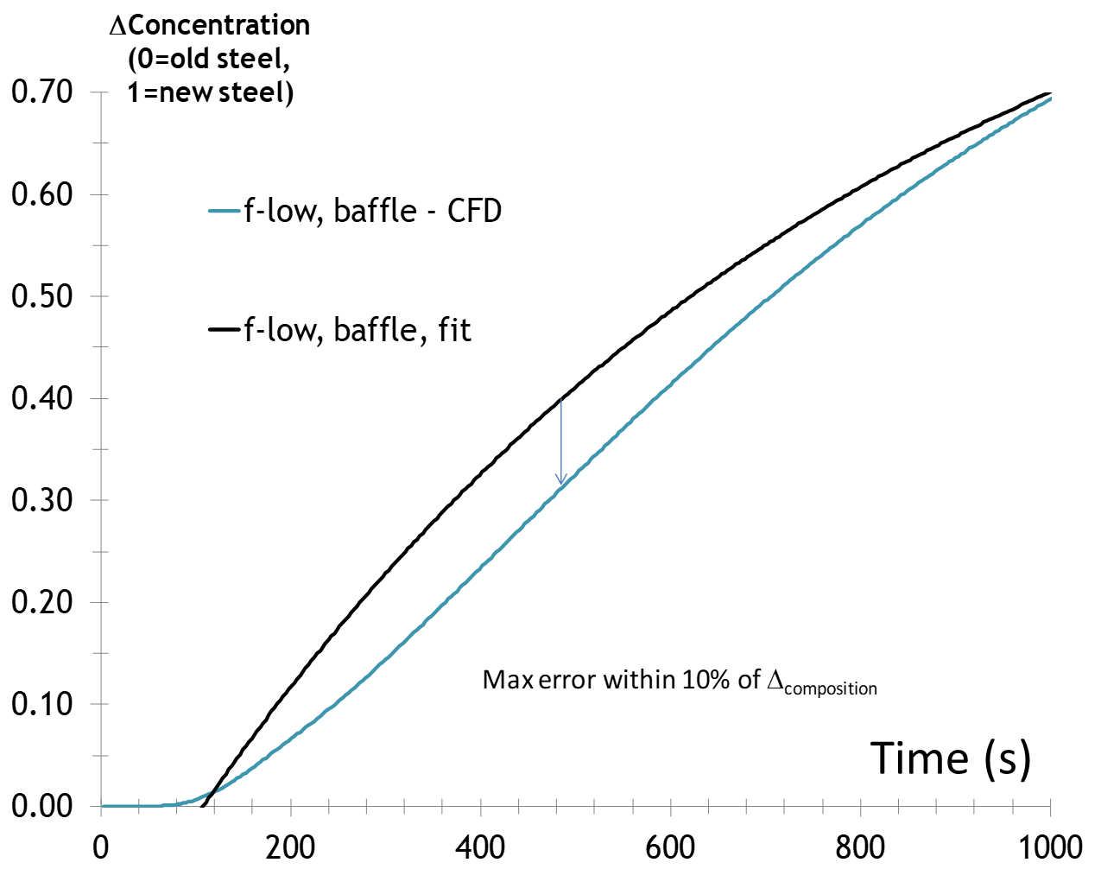
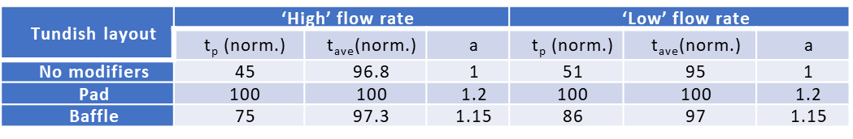
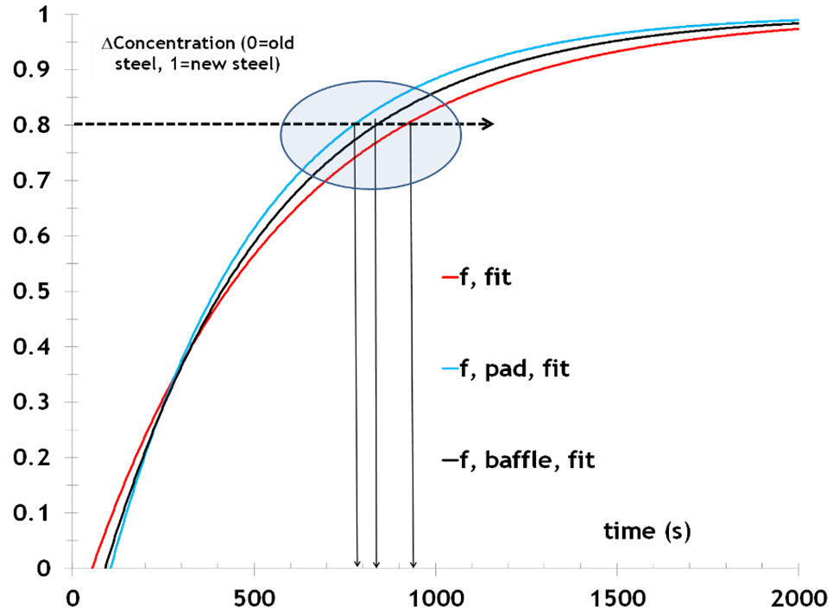
From simulation to formulation - 2
Close-up of zones with maximum fit error. multiple-hole-baffle, low flow rate.
Example of results vs flow modifiers
Case | Flow rate | Layout
1 | ‘High’ | No flow modifiers
2 |  | Pad
3 |  | Multiple-hole baffle
4 | ‘Low’ | No flow modifiers
5 |  | Pad
6 |  | Multiple-hole baffle
Curve fitting well reproducing the modelled ones

Slide 12

From simulation to formulation - 3
Model data validation by chemical analysis on slab samples (points on the curve) and comparison with plant data (screenshot of the process control system, right).

Slide 13
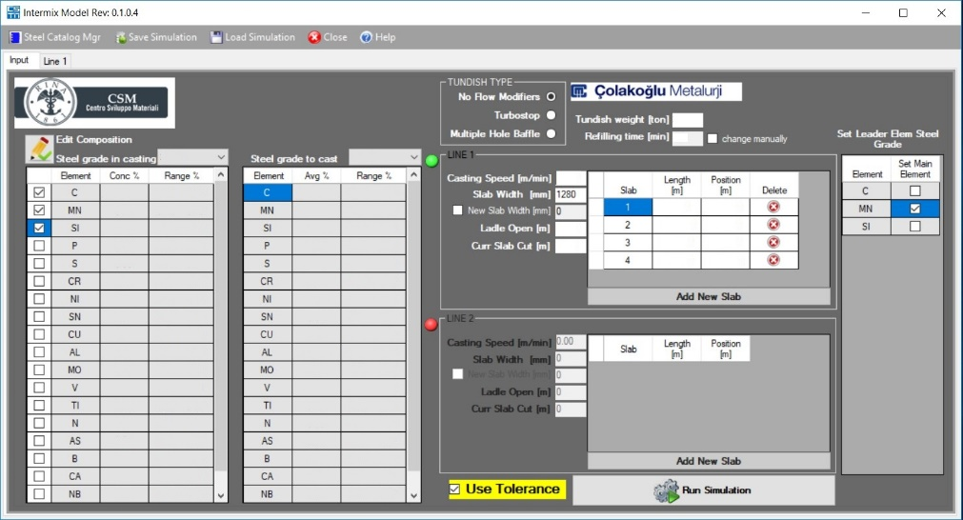
From validation to implementation - 1
Next step: implementation
Example of Input/ Output charts for the offline tool developed

Slide 14
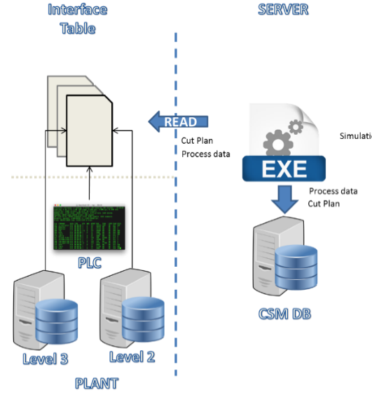

From validation to implementation - 2
Final step route to problem solving : implementation
Information flow for the on-line tool developed
on-line tool output interface

Slide 15


Conclusions
The tool has been integrated into the Colakoglu CC2 control system and is currently used offline for optimizing a priori mixed grade production scheduling, and online for slab cutting optimization to reduce the downgraded product amount.
For its nature, the model and the related off- and on-line tools can be generally applied to any other casting plant, after a preliminary tuning on well-defined plant operations.
This is an example of how fundamentals can support problem solving, even up to setting up process monitoring/control tools

Slide 16
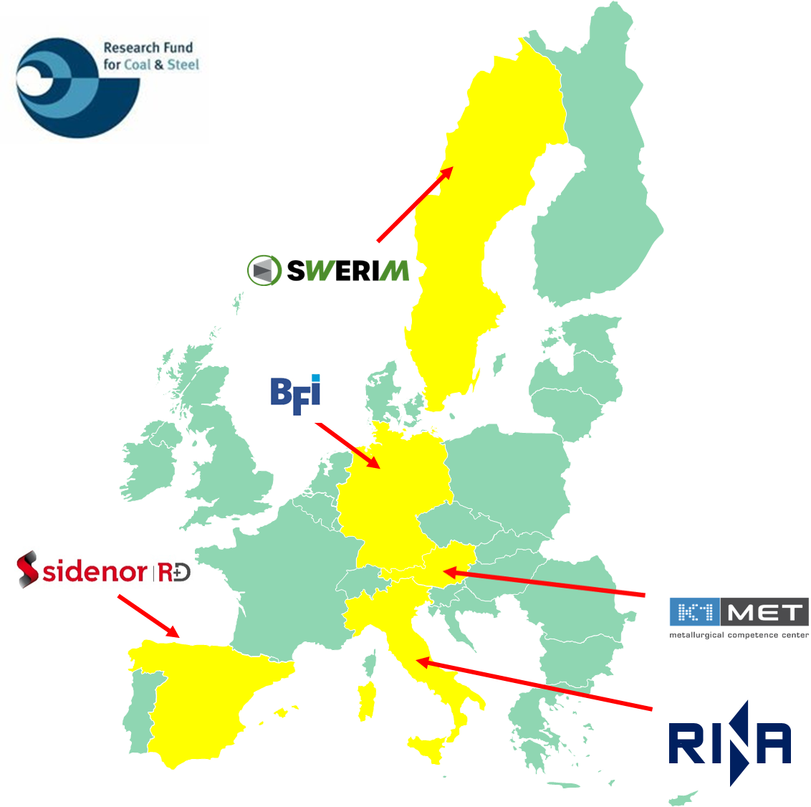

a
a
!
Thank you for your attention!
Contact mail: Michele.desantis_csm@rina.org

